Slide 1
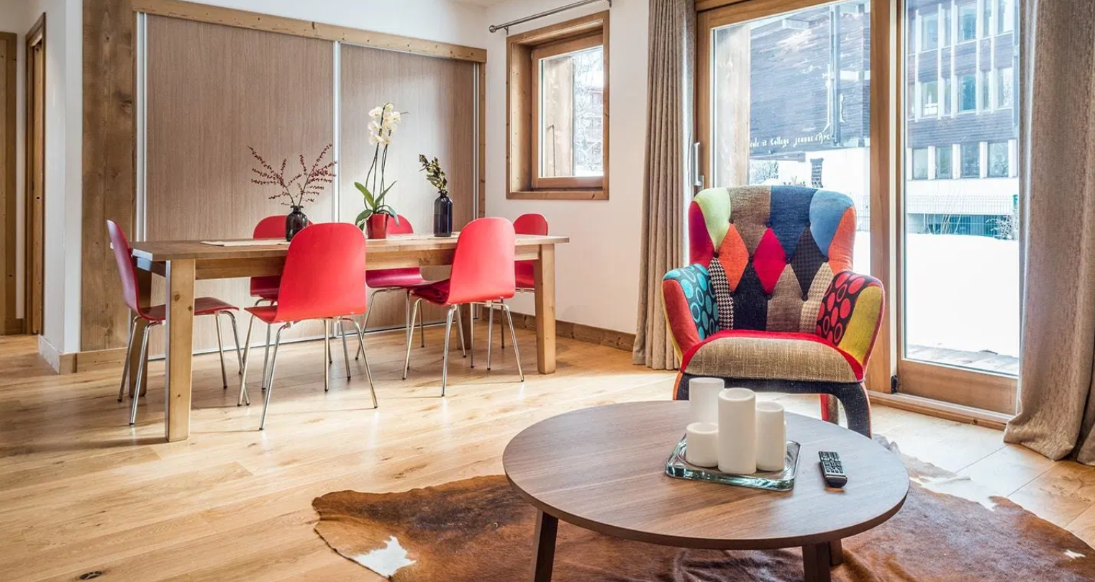

Group 7:
Daniel Liao
Kashish Vermani
Gowtham Konda
Pradeep Munikrishnan
BUAN 6340 :Programming for Data Science
Section: 002

Slide 2
Table of Contents
01
02
03
04
Introduction
Project Description
Process Description
Data Acquisition & Exploration
What is Data Science?
What is Airbnb? &
Project Objectives
Brief explanation of the various steps involved in planning , execution and implementation
Collecting the data from the source and exploring it to understand the data better
05
06
07
08
Exploratory Data Analysis
Data Wrangling & Partitioning
Data Modelling
Closure
Analyzing with statistical techniques to know the insights.
Process the data to be suitable for modelling and then partitioning it.
Building various machine learning algorithms to achieve the objective
Choosing the best algorithm based on various metrics and implementing the same.
Notes:
© Copyright Showeet.com

Slide 3
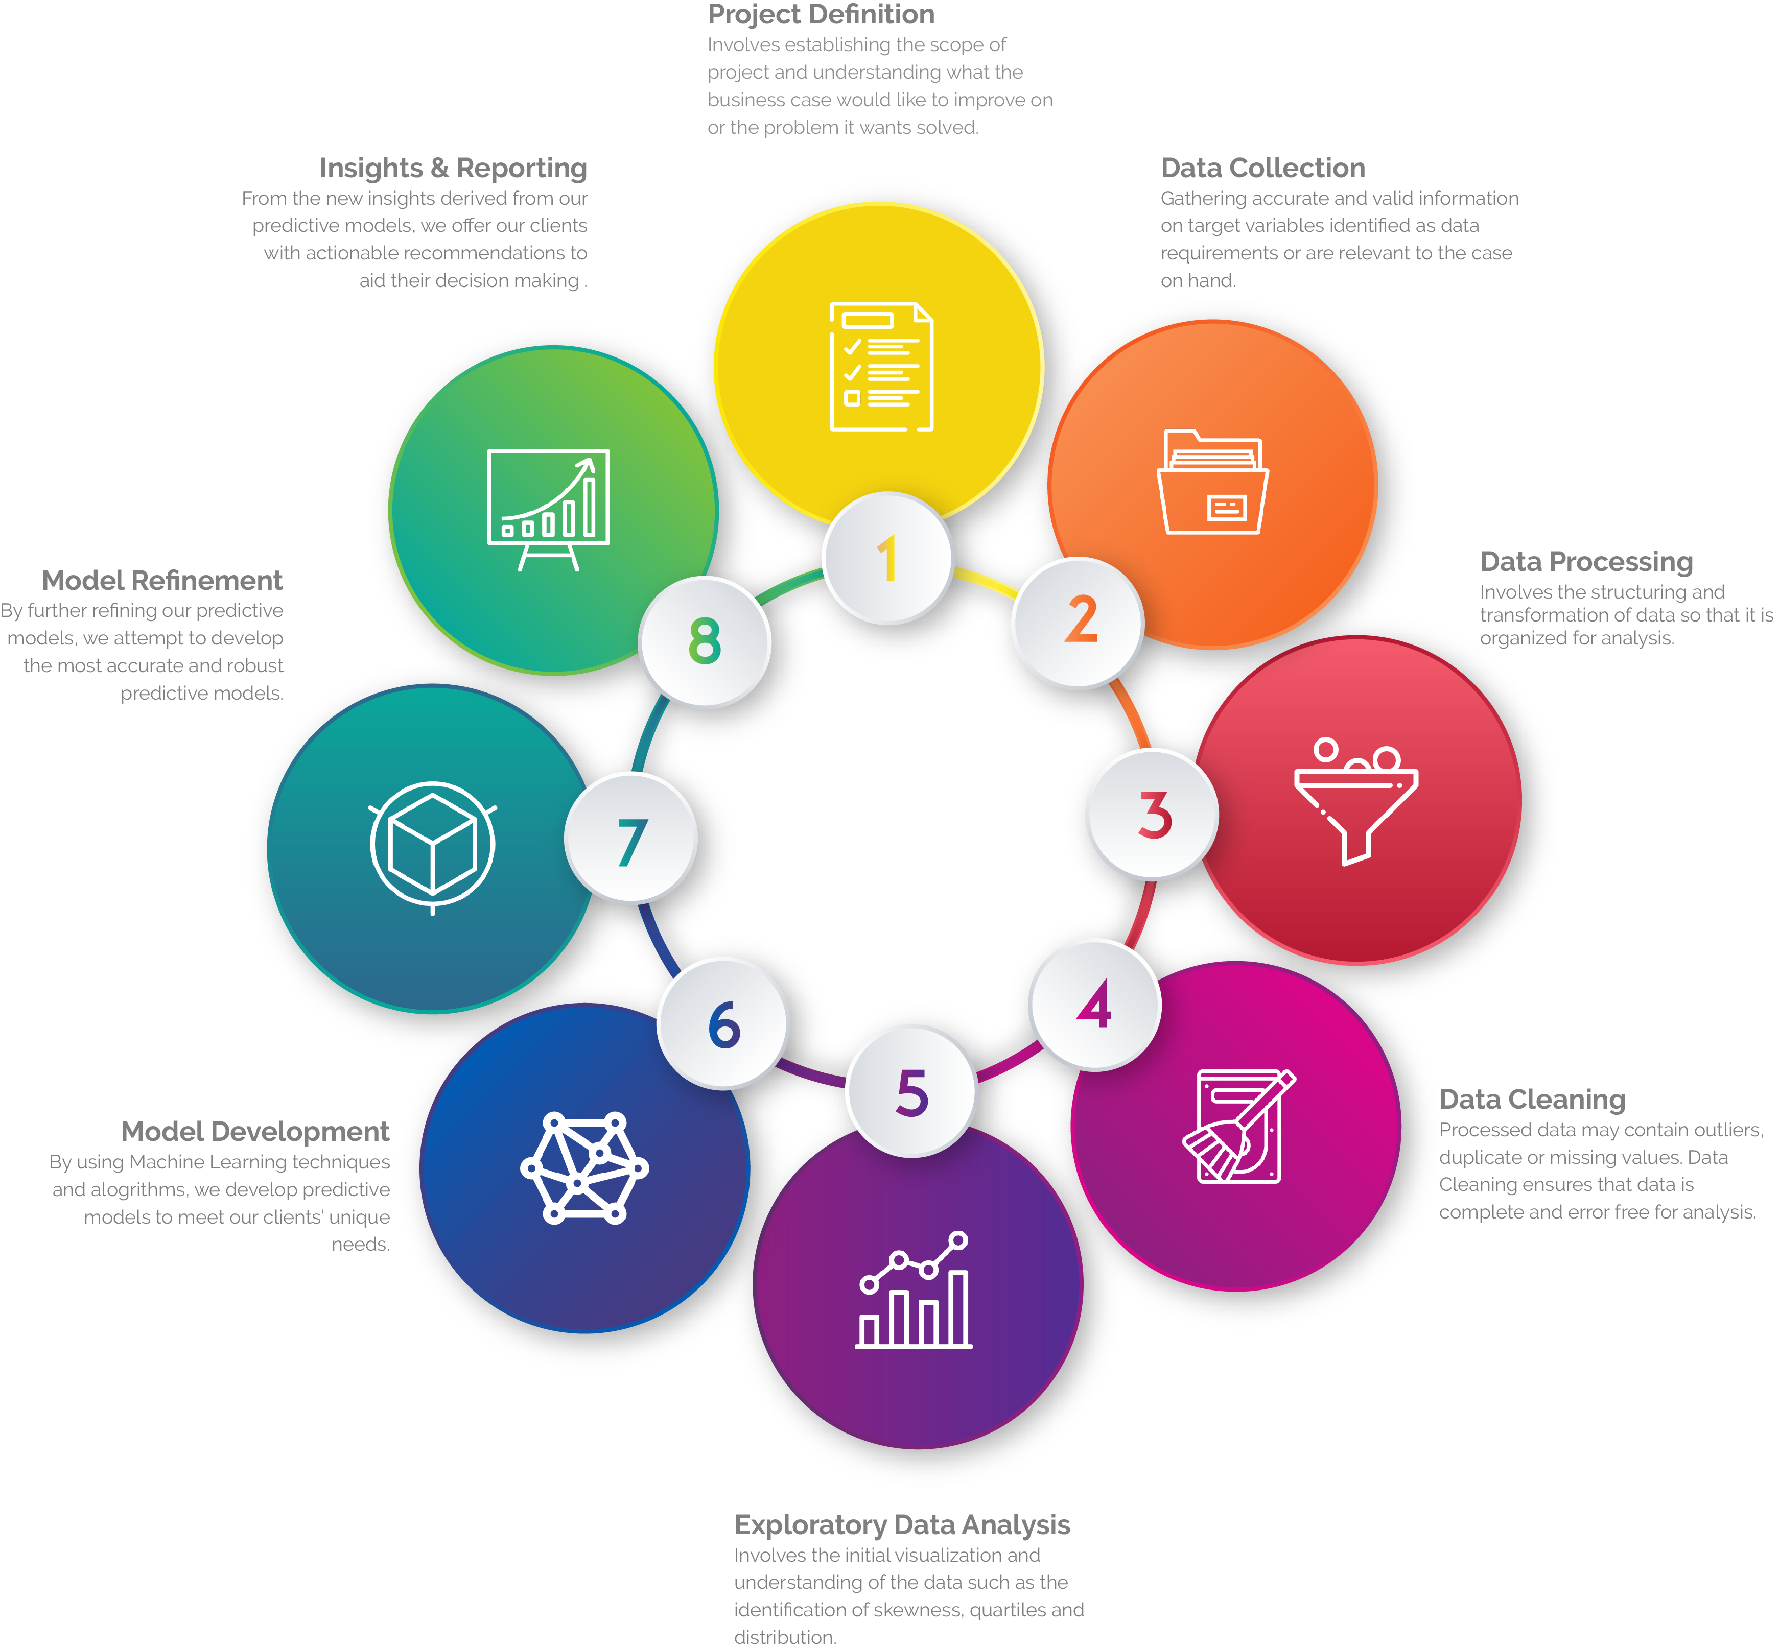
Data Science:
Data science is a "concept to unify statistics,
data analysis, machine learning and their related methods" in order to "understand and analyse actual phenomena" with data. It employs techniques and theories drawn from many fields within the context of mathematics , statistics, computer science, and information science. Turing award winner Jim Gray imagined data science as a "fourth paradigm" of science (empirical , theoretical , computational and now data-driven) and asserted that "everything about science is changing because of the impact of information technology" and the data deluge. In 2015, the American Statistical Association identified database management, statistics and machine learning, and distributed and parallel systems as the three emerging foundational professional communities.
DATA SCIENCE
LIFE CYCLE
Reference: https://en.wikipedia.org/wiki/Data_science

Slide 4


What is AirBnB?
A
Airbnb is an online marketplace for arranging or offering lodging, primarily homestays, or tourism experiences. The company does not own any of the real estate listings, nor does it host events; it acts as a broker, receiving commissions from each booking. The company is based in San Francisco, California, United States.
It is a platform that connects people who want to rent out their homes with people who are looking for accommodations in that locale. It currently covers more than 81,000 cities and 191 countries worldwide. The company's name comes from "air mattress Bed & Breakfast.”

Slide 5

PROJECT DESCRIPTION
Context
Since 2008, guests and hosts have used Airbnb to expand on traveling possibilities and present more unique, personalized way of experiencing the world. This dataset describes the listing activity and metrics in NYC, NY for 2019.
Content
This data file includes all needed information to find out more about hosts, geographical availability, necessary metrics to make predictions and draw conclusions.
ACKNOWLEGEMENT
This public dataset is part of Airbnb, and the original source can be found on this website , from which we need to collect the data.
OBJECTIVE
The Objective is to create a best model to predict the rental prices of the Airbnb listings throughout New York State & also create clusters based on all the variables to create a data structure and segment the data.
Planning ,execution & implementation
Here we will be using various machine learning algorithms to predict the best model for rental prices & segmentation then we will select the best suited one based on the metrics for implementation to achieve the goal of the project.
Notes:
© Copyright Showeet.com

Slide 6




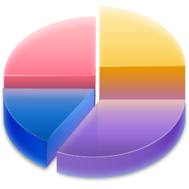

PROCESS DESCRIPTION
01
03
05
07
Data Acquisition
The process of collecting the data from the source
Exploratory Data Analysis
Primarily EDA is for seeing what the data can tell us beyond the formal modelling or hypothesis testing task
Data Partitioning
The process of splitting the data into train , validation and test for building a model
Model Selection
Based on various metrics the best model will be chosen for implementation
02
04
06
Data Exploration
Data exploration is an approach which uses visual exploration to understand the dataset, rather than through traditional data management systems
Data Wrangling
Data wrangling is the process of cleaning(skewness ,outliers ,duplicates ) and unifying messy and complex data sets for easy access and analysis. It is also known as Data pre-processing and manipulation
Data Modelling
Modelling is the statistical technique that is chosen to find trends, patterns, and relationships within existing data, staged in the first phase of the data wrangling process.
Notes:
© Copyright Showeet.com

Slide 7
DATA ACQUISITION
The data can be downloaded from the Kaggle website which has been hosted by Airbnb
The data dictionary of the dataset which contains the detailed explanation of the various features present in it, also needs to be explored
The dimensions of the dataset is 48,895 x 16
Data Dictionary:
id: listing ID
name: name of the listing
host_id: host ID
host_name: name of the host
neighbourhood_group: location
neighbourhood: area
latitude: latitude coordinates
longitude: longitude coordinates
room_type: listing space type
price: price in dollars
minimum_nights: amount of nights minimum
number_of_reviews: number of reviews
last_review: latest review date
reviews_per_month: number of reviews per month
calculated_host_listings_count: amount of listing per host
availability_365: number of days when listing is available for booking

Slide 8
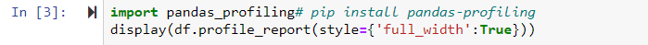
DATA EXPLORATION
After acquiring the dataset from the source we can explore it to understand the various features present in the dataset and its characteristics
In python, there is a special package to do this all exploration of data in to a single step known as pandas-profiling
The pandas-profiling Python package is a great tool to create HTML profiling reports. For a given dataset, it computes the following statistics:
Essentials: type, unique values, missing values.
Quantile statistics like minimum value, Q1, median, Q3, maximum, range, interquartile range.
Descriptive statistics like mean, mode, standard deviation, sum, median absolute deviation, coefficient of variation, kurtosis, skewness.
Most frequent values.
Histogram.
Correlations highlighting of highly correlated variables, Spearman and Pearson matrixes.

Slide 9

Notes:
LiveSlide https://pfdsyin.000webhostapp.com/index.html

Slide 10
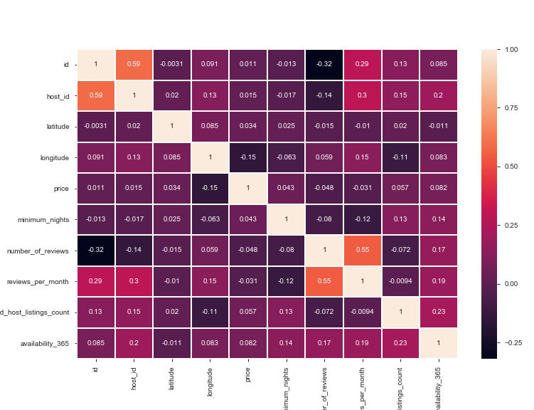
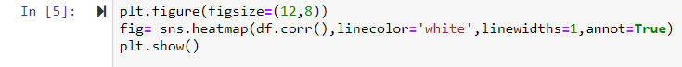
EXPLORATORY DATA ANALYSIS
At first we will try to find the strength of the correlation between target variable and all the other variables by using the heat map

Slide 11
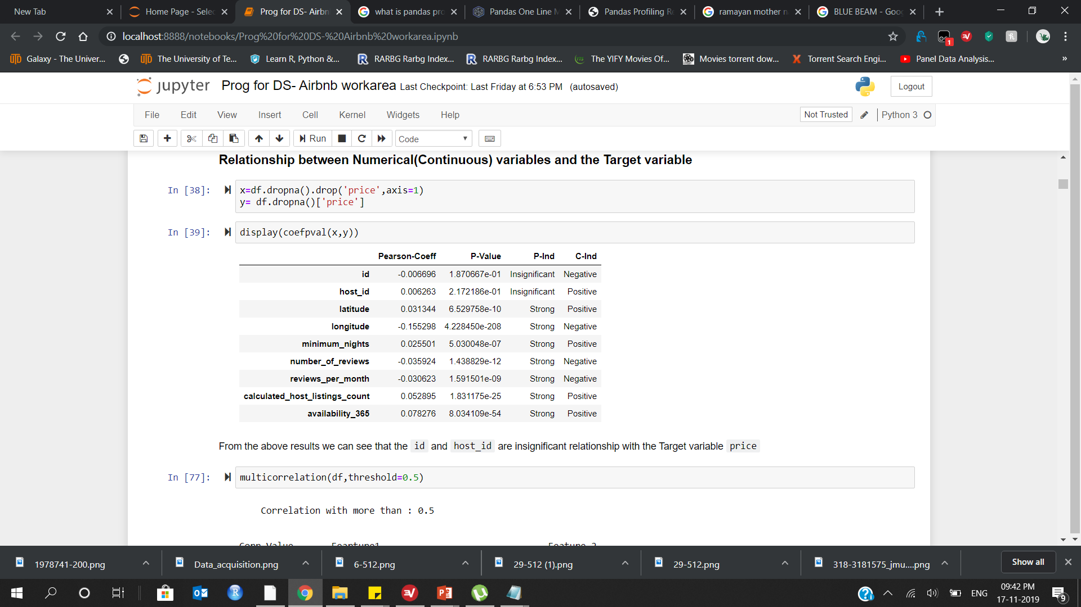

Now, we will check the insignificant features with respect to the target variable based on p-values
by using as user-defined function

Slide 12
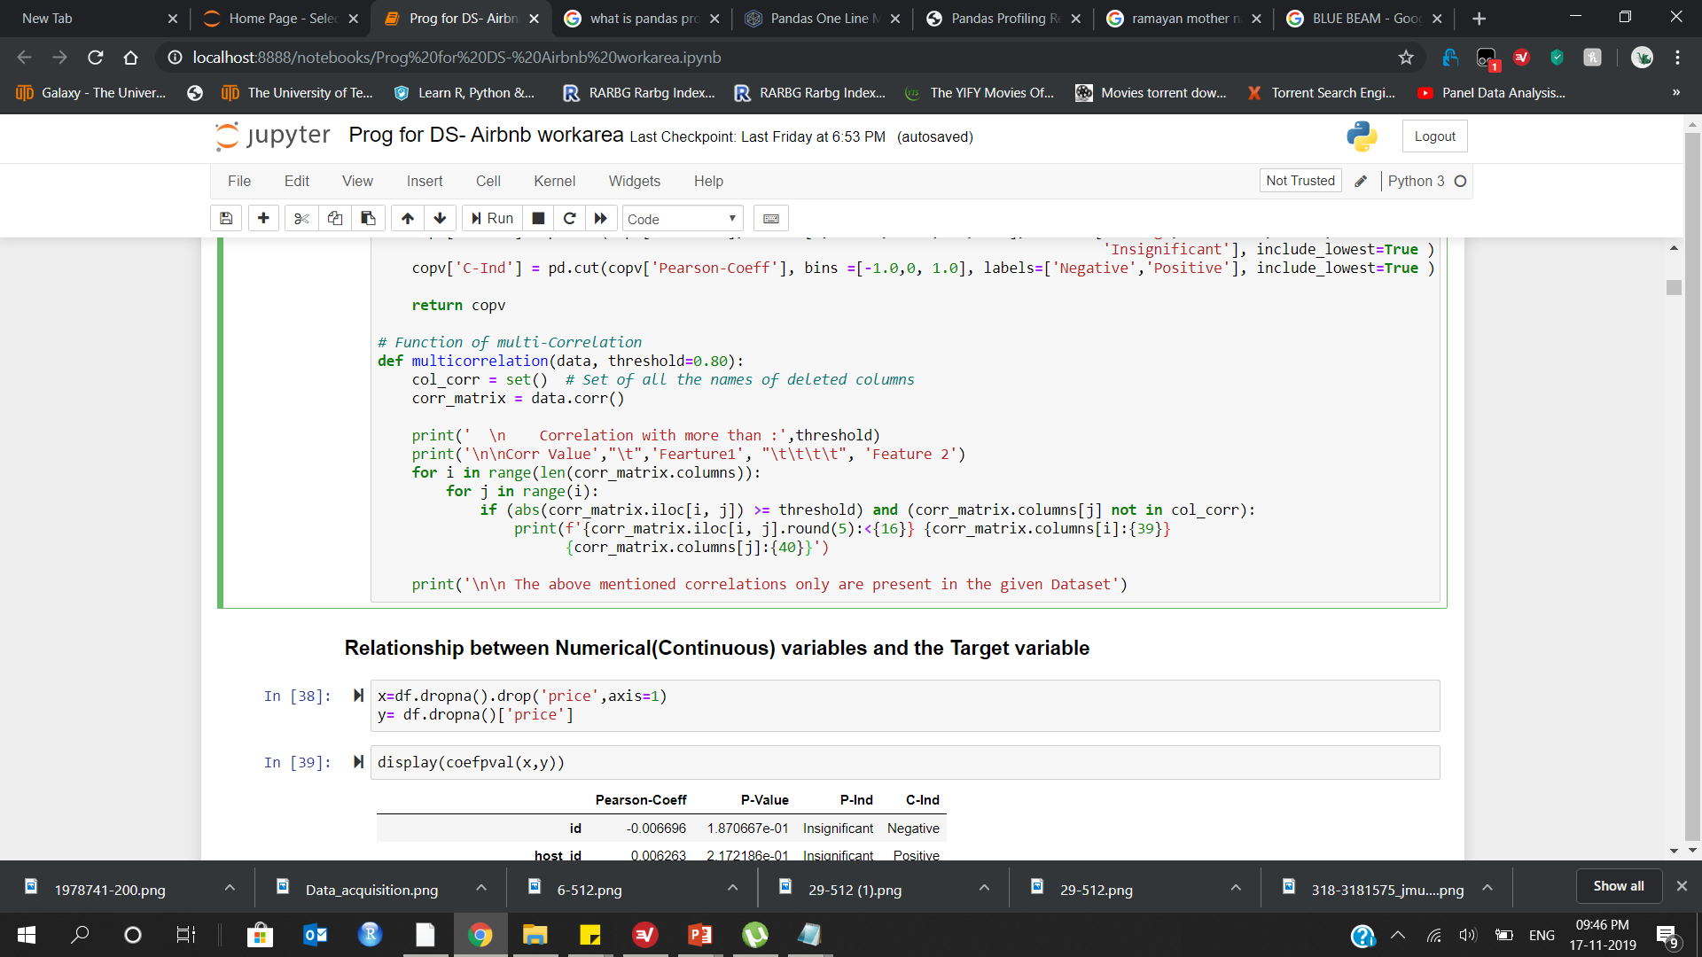
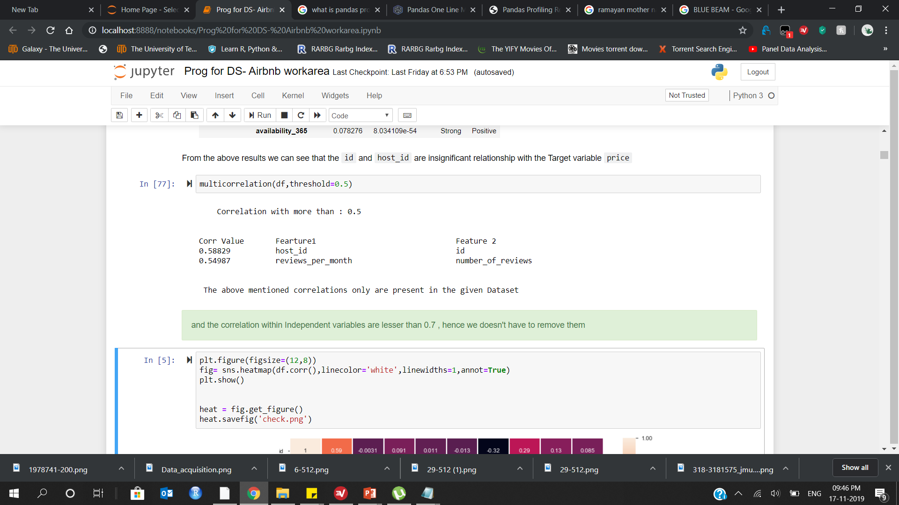
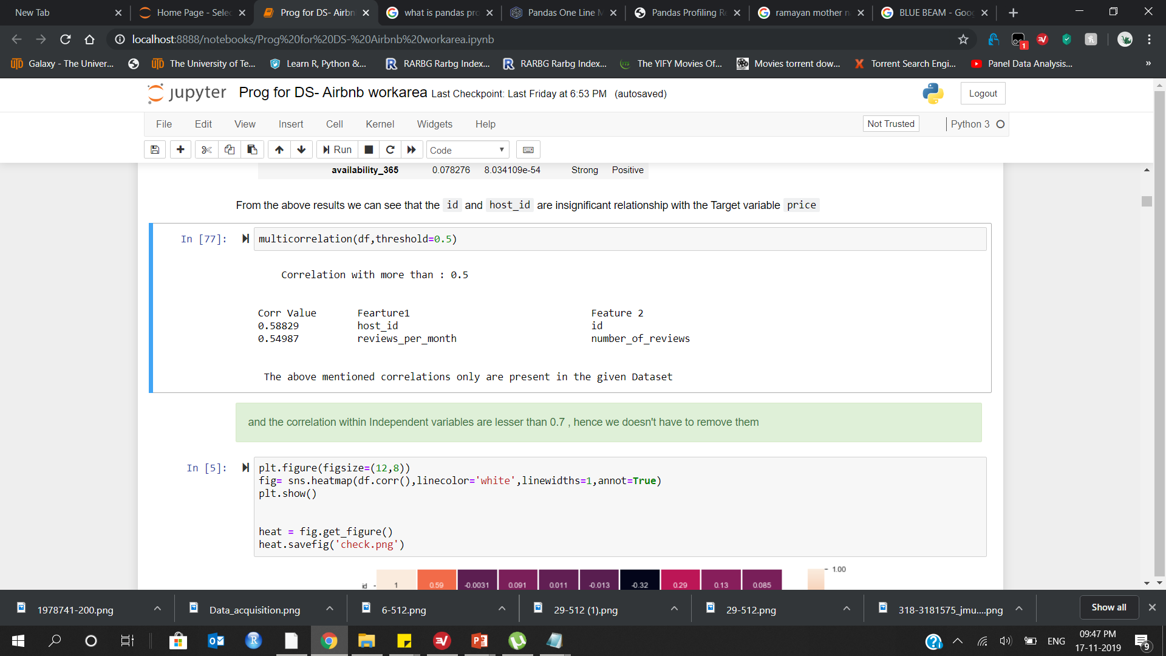
Now, we will check whether any multi-correlation is present between the independent variables
In the dataset by using user-defined functions

Slide 13
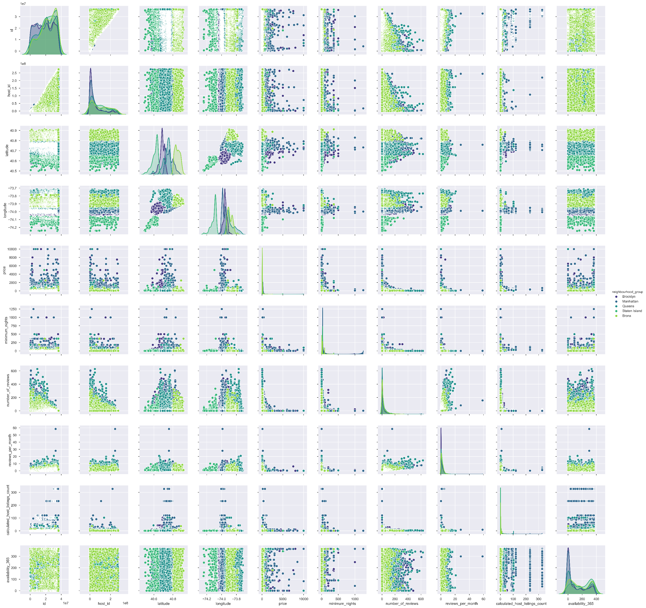
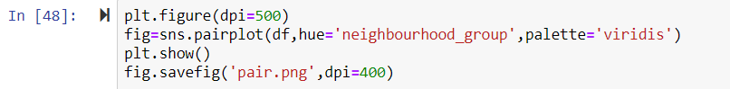
Pairplot will be used to find, whether any variable can be able to differentiate the price distribution. Here we will be using the ‘neighbourhood_group’ feature.
Now, we will explore about the ‘neighbourhood_group’ and ‘neighbourhood’ variables and its explanation

Slide 14
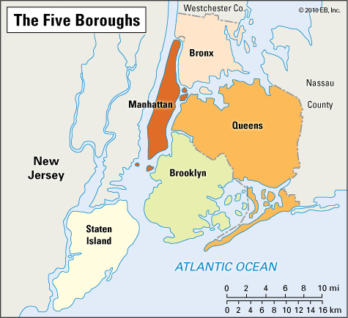
The New York City encompasses Five county-level administrative divisions called `"Boroughs"`:
1. Bronx
2. Brooklyn
3. Manhattan
4. Queens
5. Staten Island
Each borough is coterminous with a respective county
of New York State
Reference: https://en.wikipedia.org/wiki/Boroughs_of_New_York_City

Slide 15
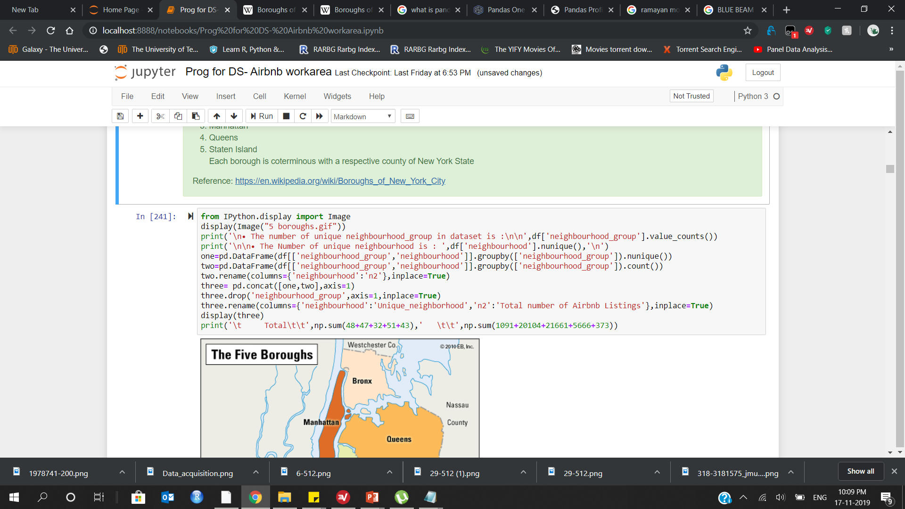
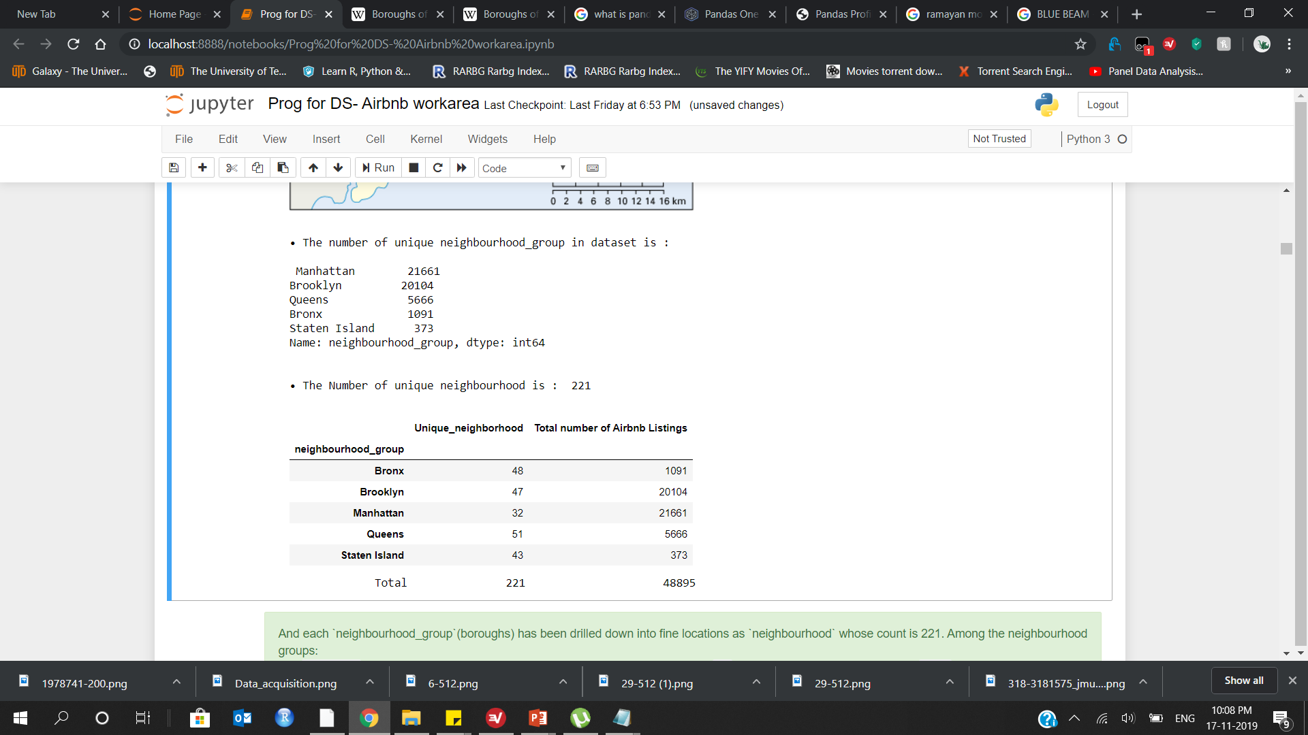

Slide 16



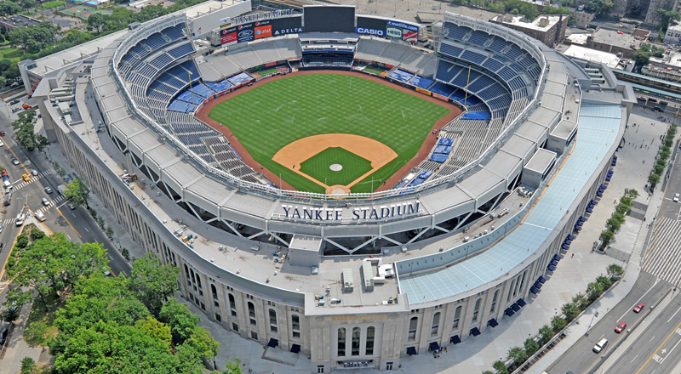
Insights
Manhattan
Neighbourhood cnt- `32’
Airbnb listings - `21,661`
High Popularity
Therefore we can expect that the average rental price to be higher than the other boroughs
Brooklyn
Neighbourhood cnt -`47`
Airbnb listings -`20,104`
High Popularity
Therefore we can expect that the average rental price to be higher than the other boroughs but as same as Manhattan
Queens
Neighbourhood cnt- `51`
Airbnb listings- ‘5666`
Moderate Popularity
Hence we can expect a low average rental price for this borough
Bronx
neighbourhood cnt -`48`
Airbnb listings- `1,091`
Less Popularity
Hence we can expect a low average rental price for this borough
Notes:
© Copyright Showeet.com – Free PowerPoint Templates

Slide 17
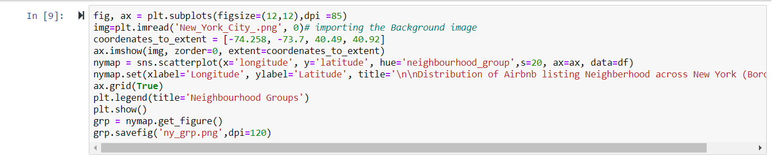
Let’s Visualize the number of Airbnb listings on New York map to know the density of all the listing in each ‘neighbourhood_group’(boroughs)

Slide 18
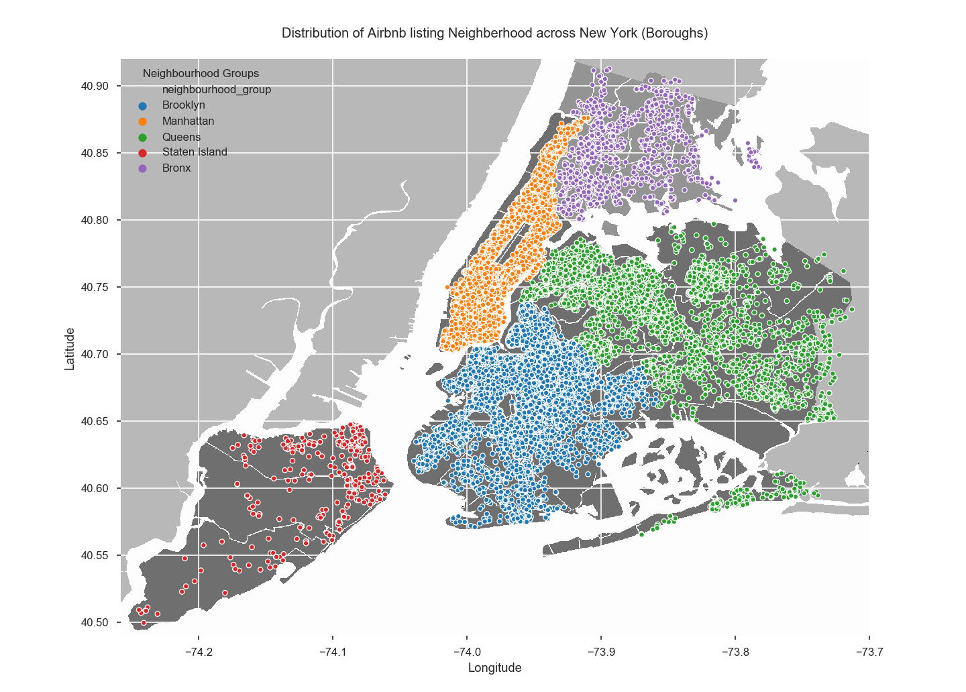

Slide 19
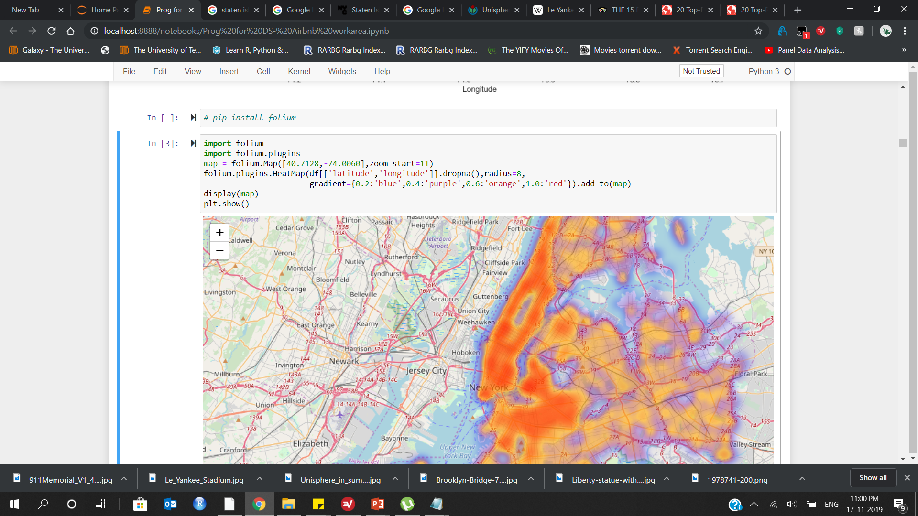
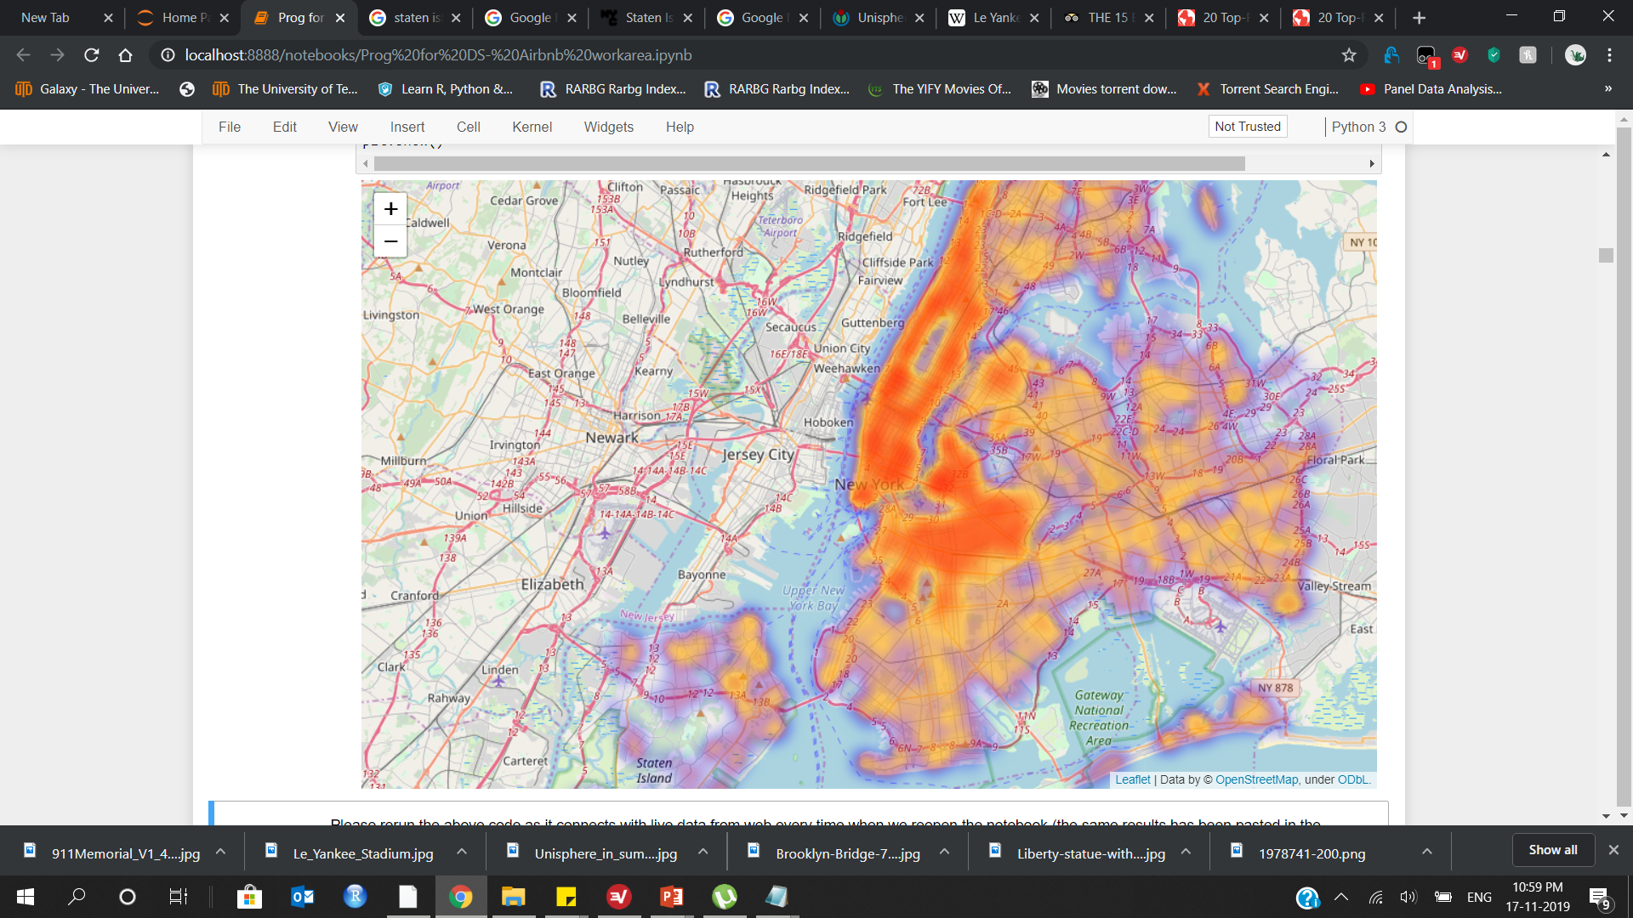

Slide 20
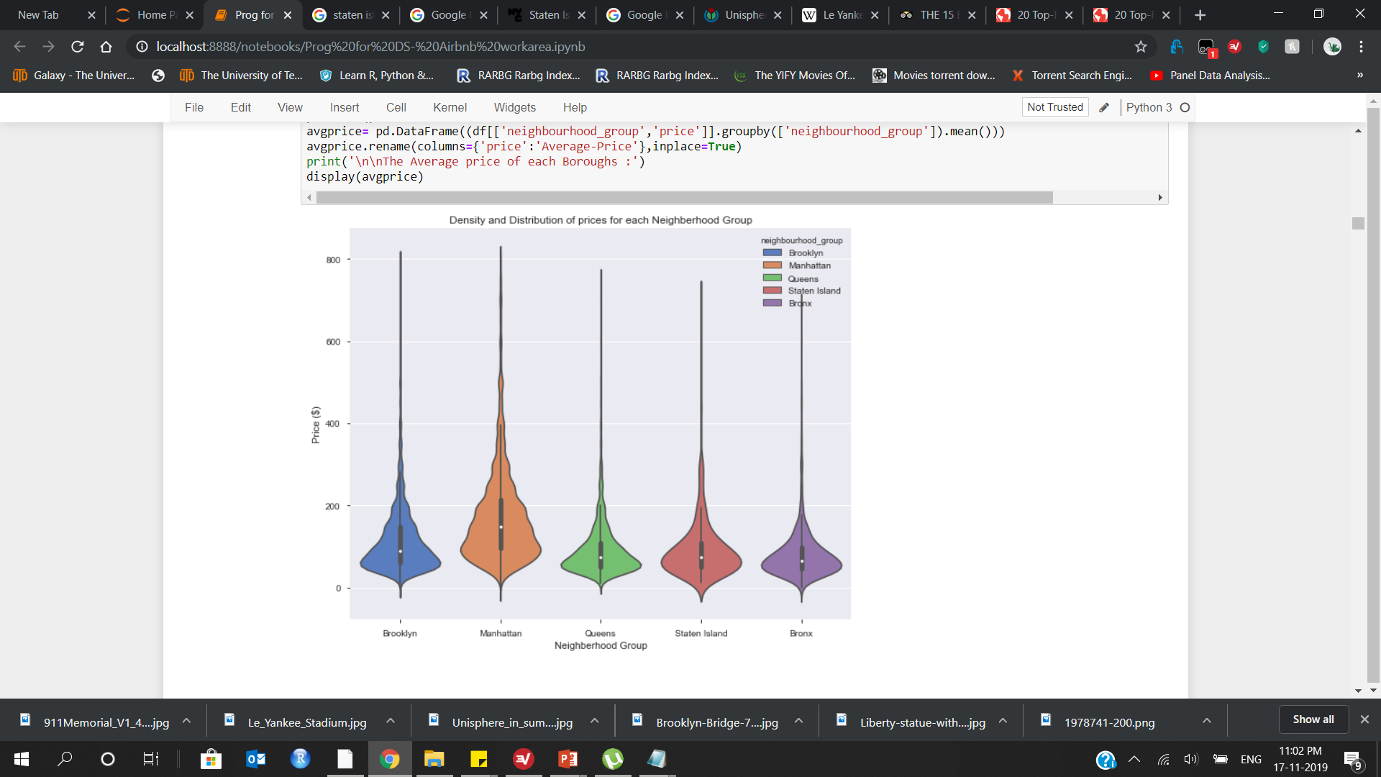
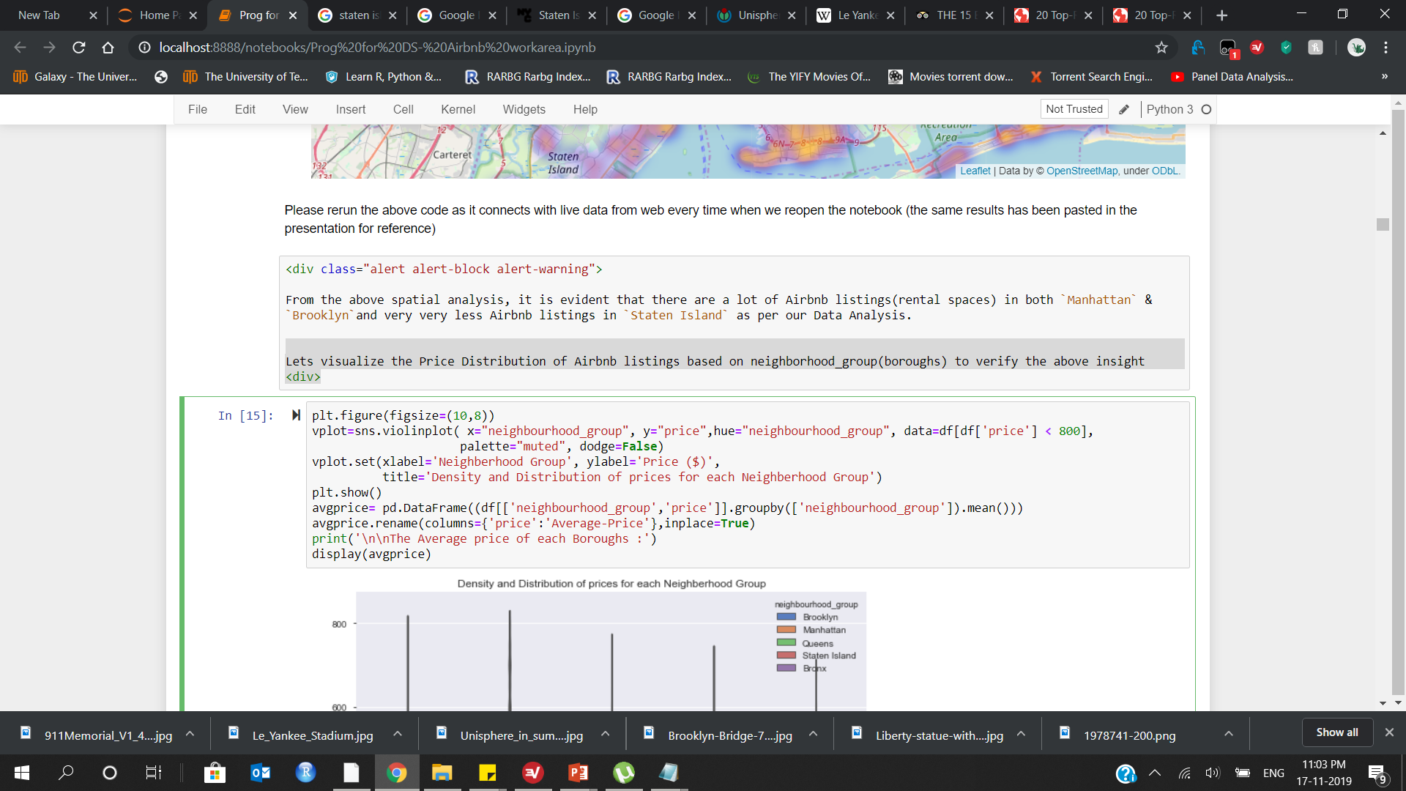
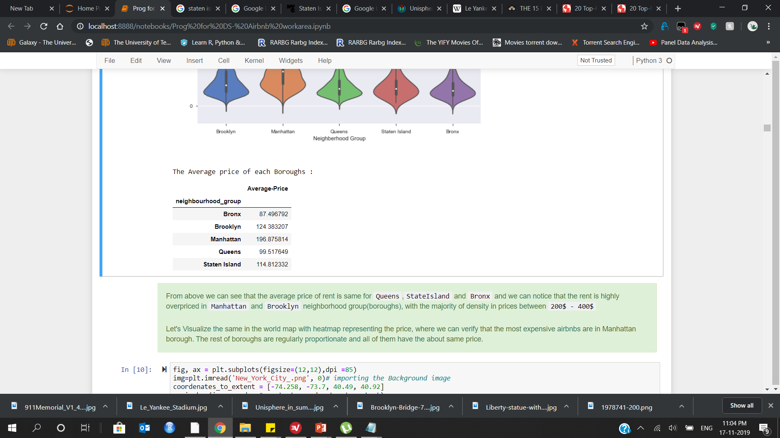
Lets visualize the Price Distribution of Airbnb listings based on neighborhood_group(boroughs) to verify the above insight
By using violin plot

Slide 21
RANKING OF BOROUGHS
QUEENS
STATEN ISLAND
The average rental price in this borough is $ 99.51
The average rental price in this borough is $ 114.81
BRONX
The average rental price in this borough is $ 87.49
BROOKLYN
The average rental price in this borough is $ 124.38
04
03
02
05
Manhattan
The average rental price in this borough is $ 196.87
01
Notes:
© Copyright Showeet.com – Creative & Free PowerPoint Templates

Slide 22
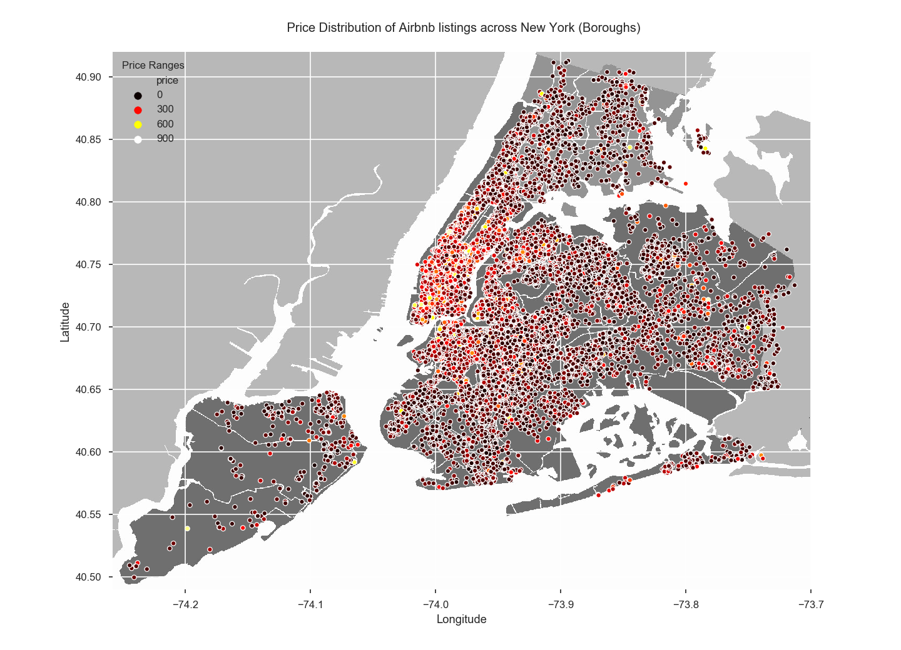

Slide 23
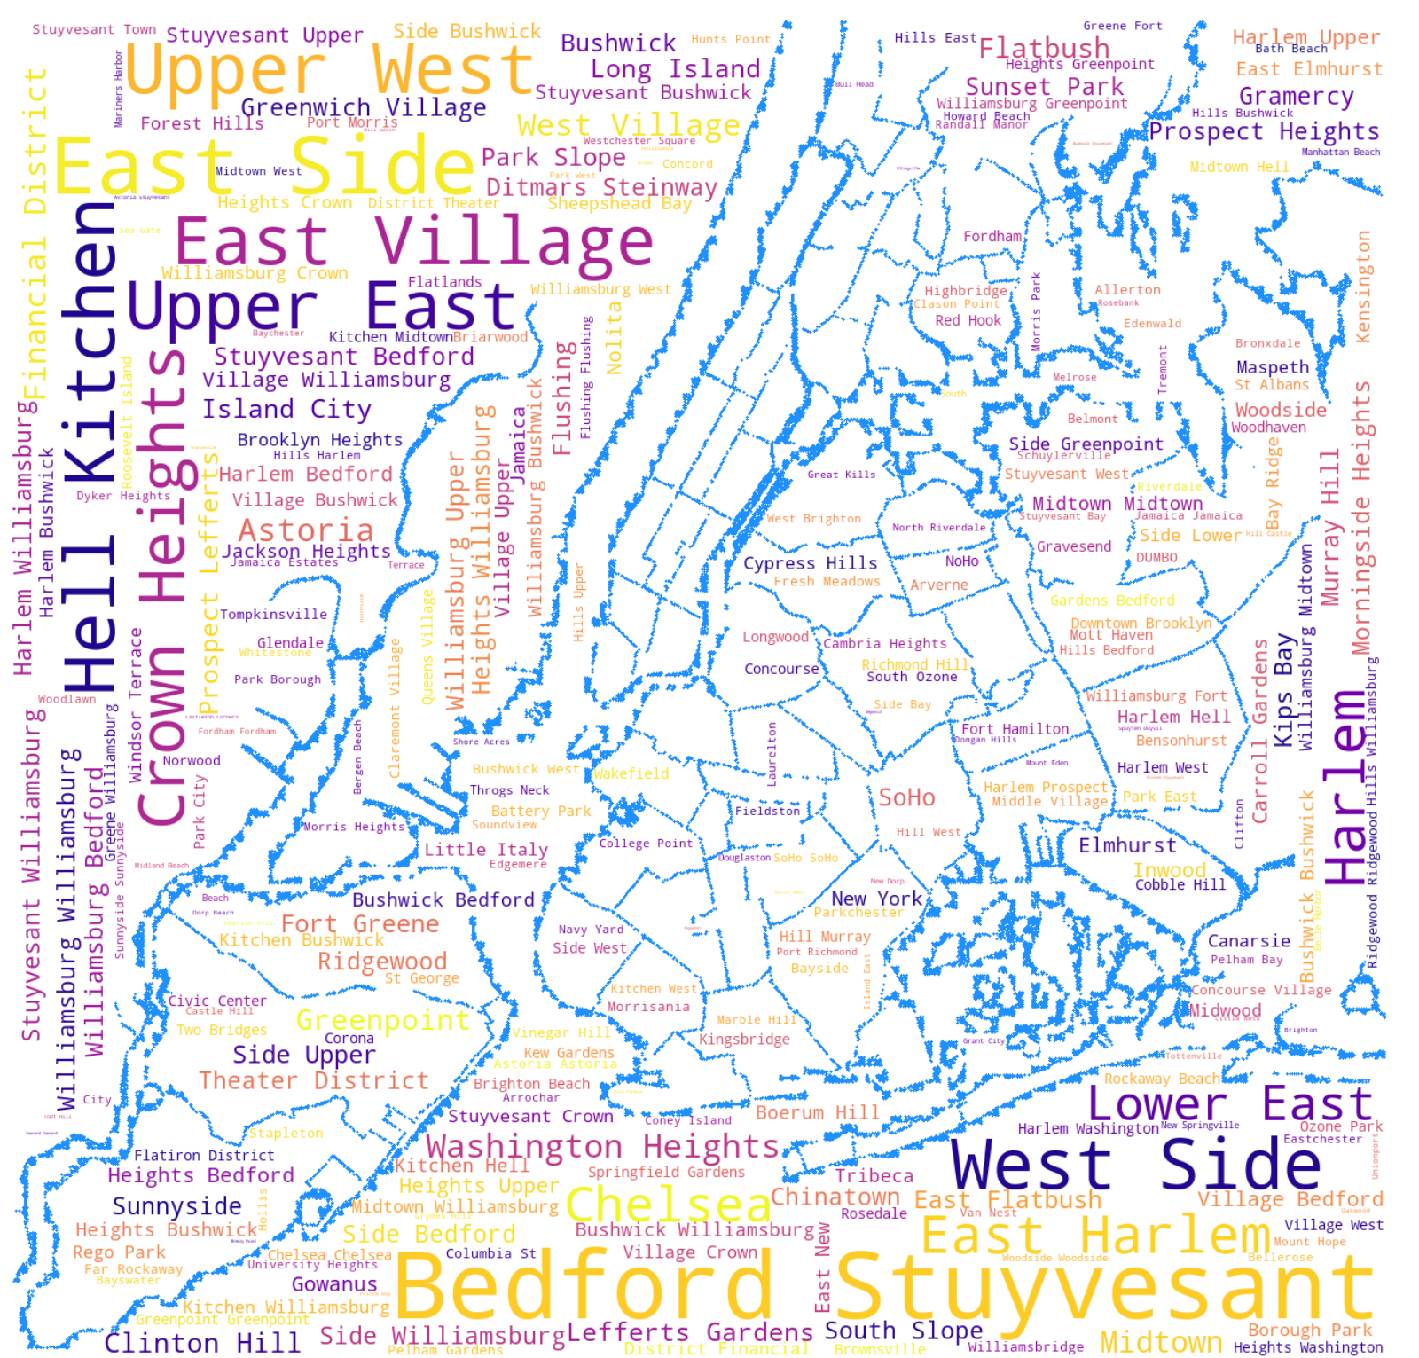
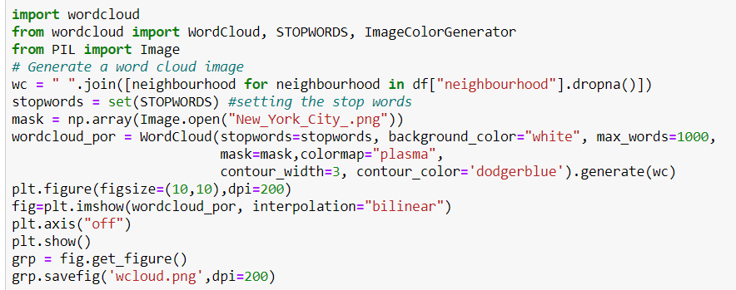
Among all the neighbourhoods (Airbnb listings-221), which neighbourhood is the most popular ones(frequency of names in the dataset) by using Word cloud
if we simply use the value_counts() over the dataset we will be getting 221 rows of crunching numbers and in bar charts we will get 221 bars which is too clumsy
Hence we can visualize the same in wordcloud, as the better form of representing the data.
Here we will be plotting the word cloud on the map of New York itself!

Slide 24
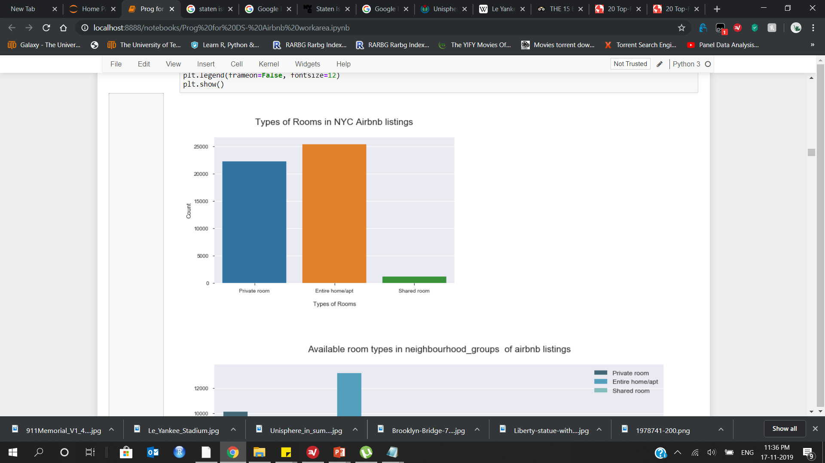
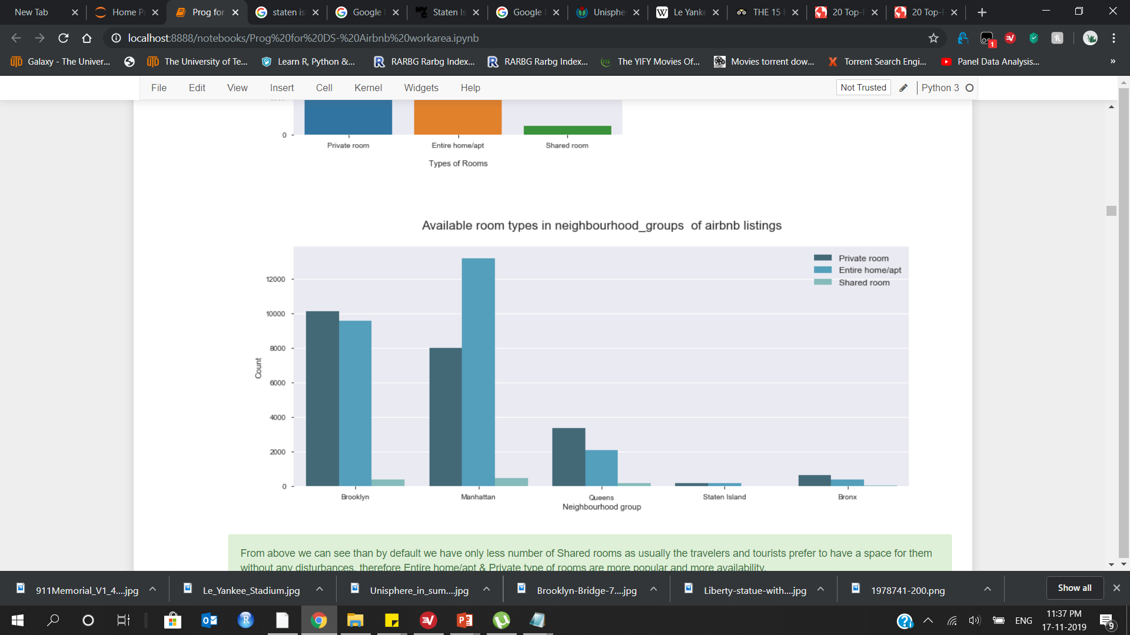
Let's analyse the other categorical features:
There are 3 types of Rooms available in the above mentioned neighbourhoods(221)
Entire home/apt
Private room
Shared room
let's visualize the dataset and verify how many rooms are there in each type of rooms and also how much rooms are available in each type in each neighbourhood_group (boroughs)

Slide 25
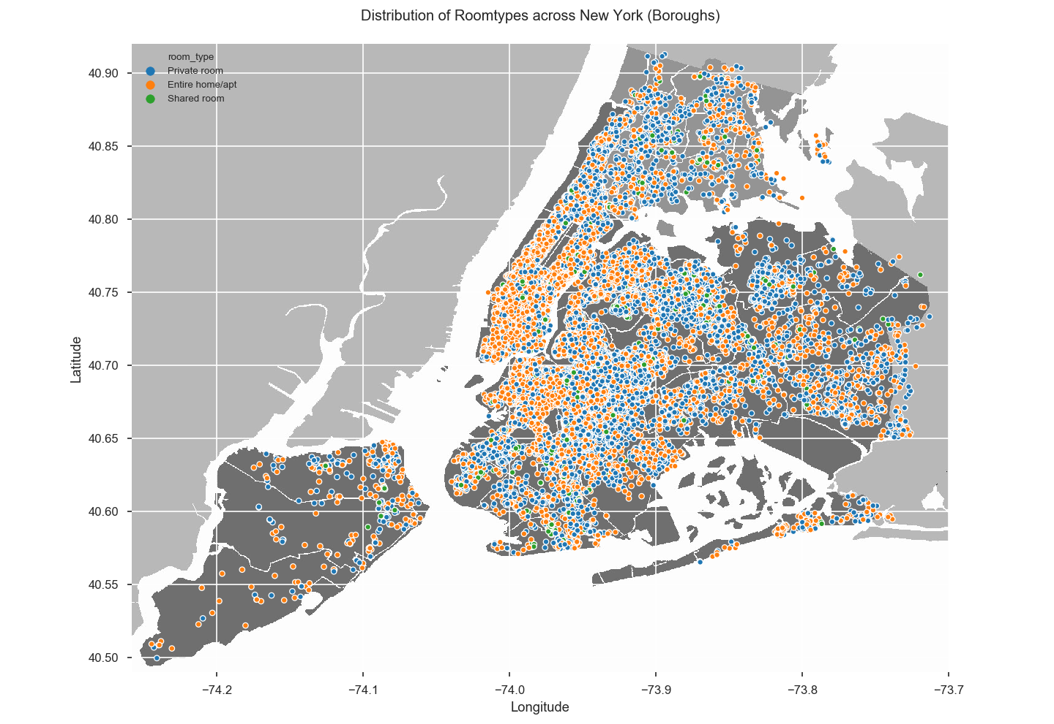
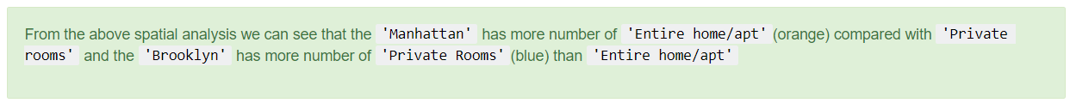

Slide 26
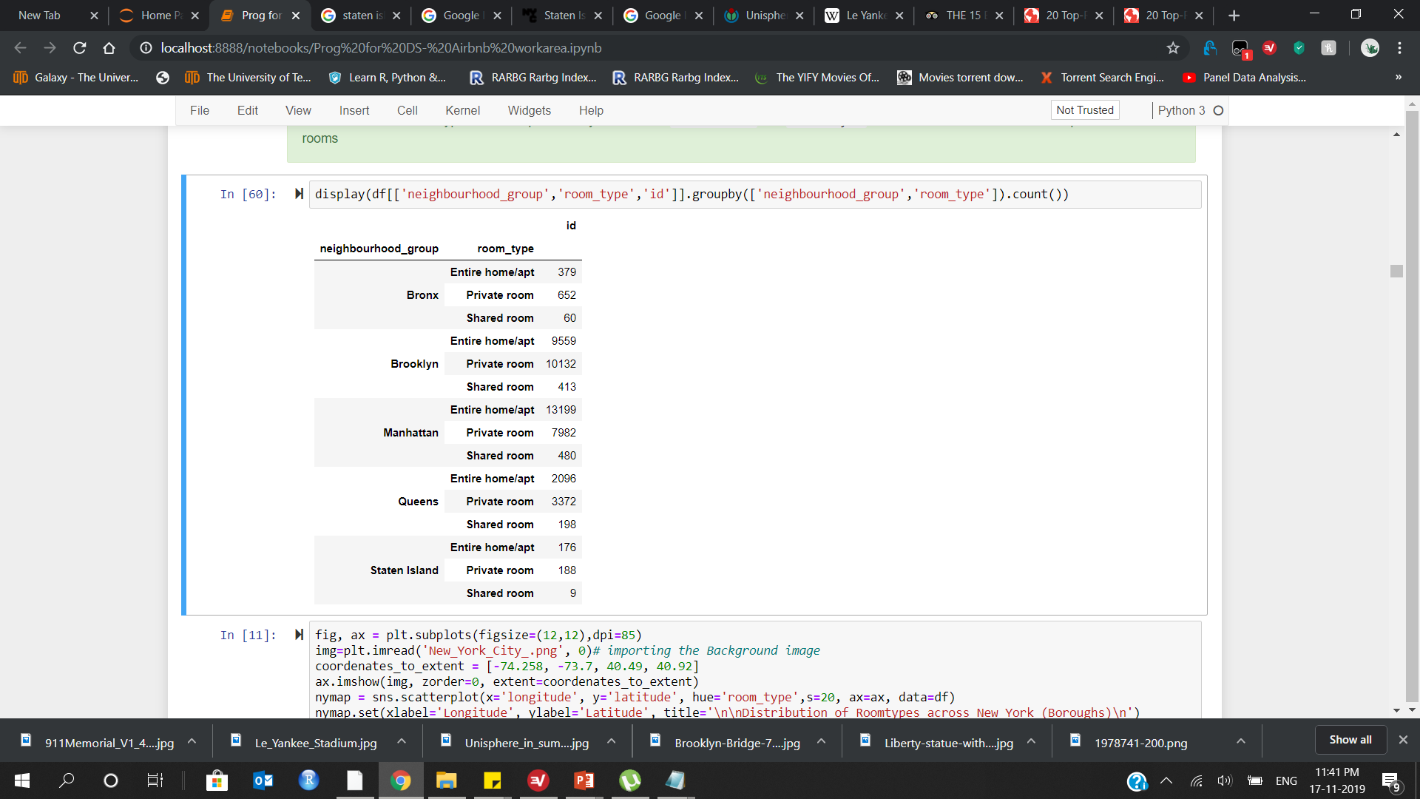
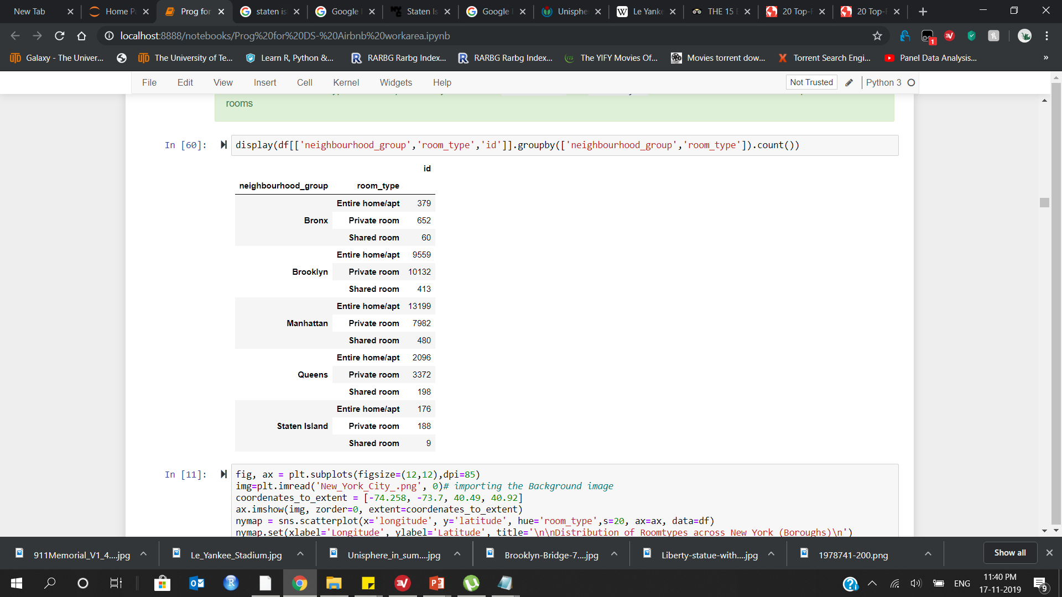
Distribution of room types in each neighbourhood_group (boroughs)

Slide 27
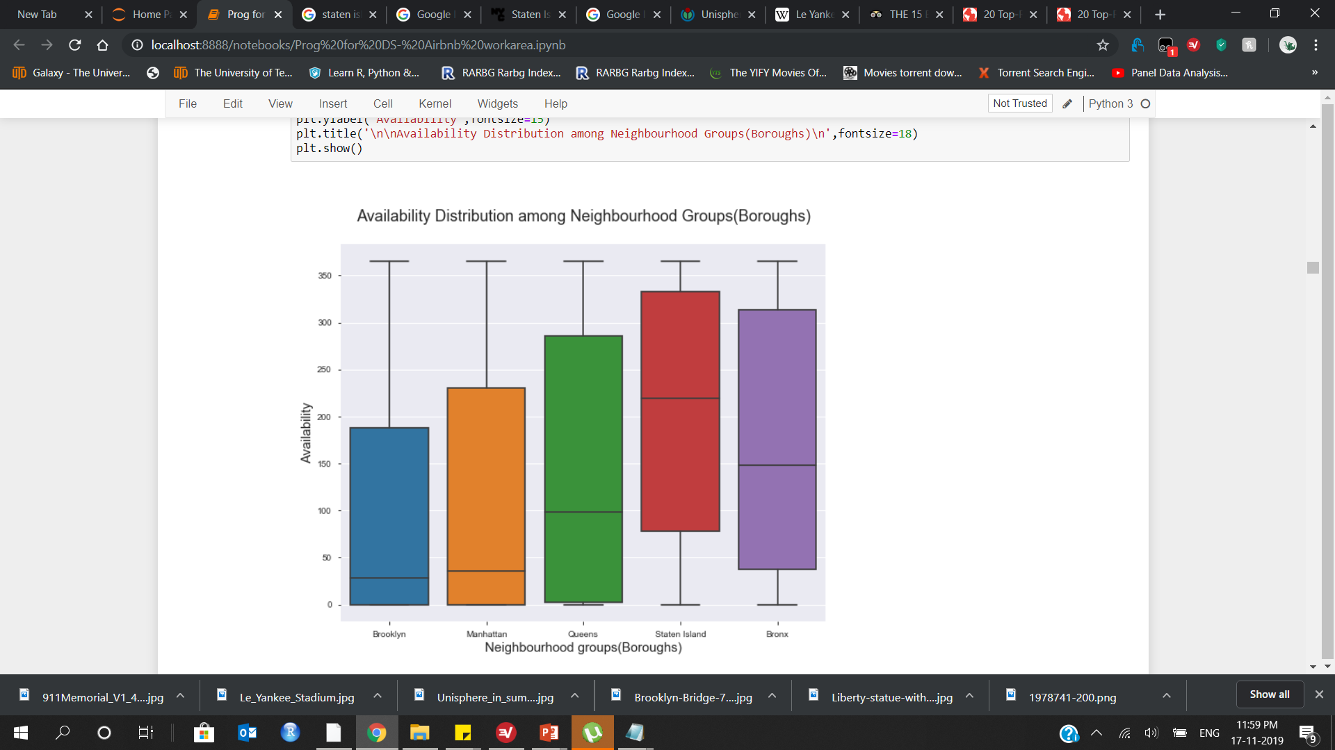
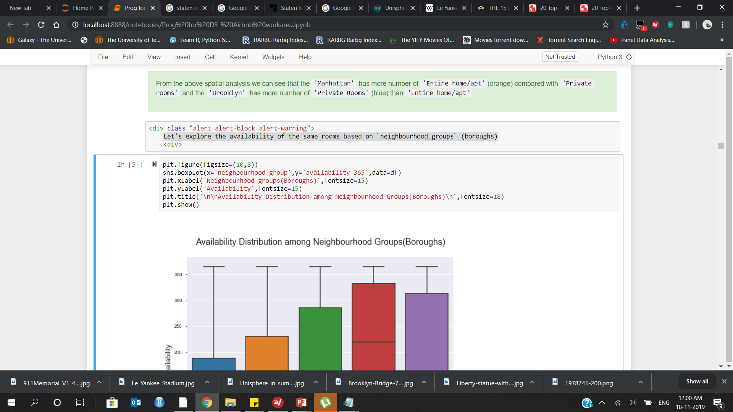
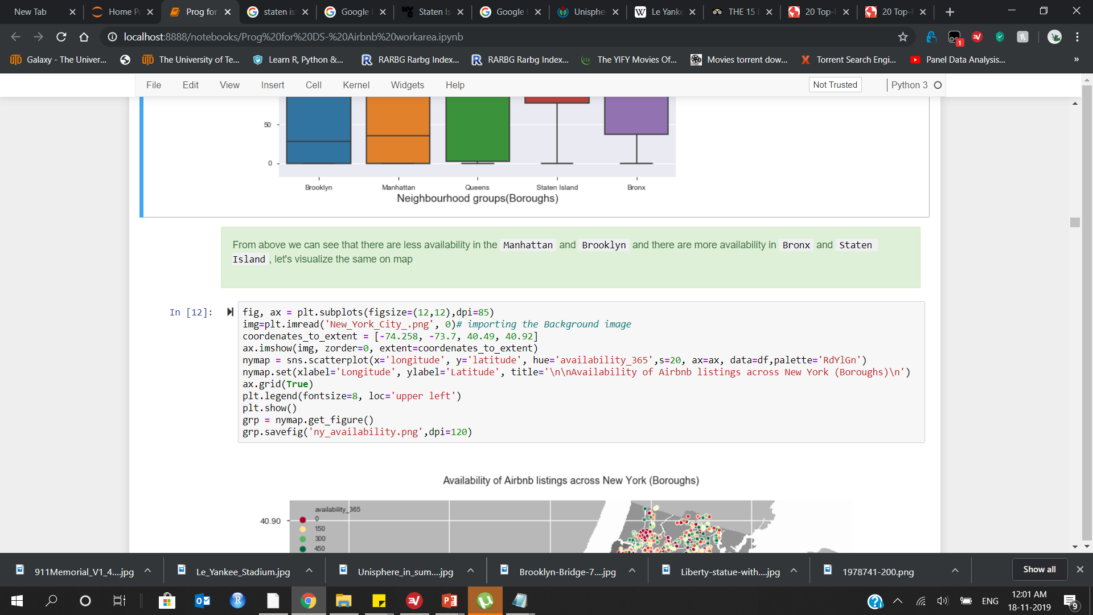
Let's explore the availability of the same rooms based on `neighbourhood_groups` (boroughs)

Slide 28
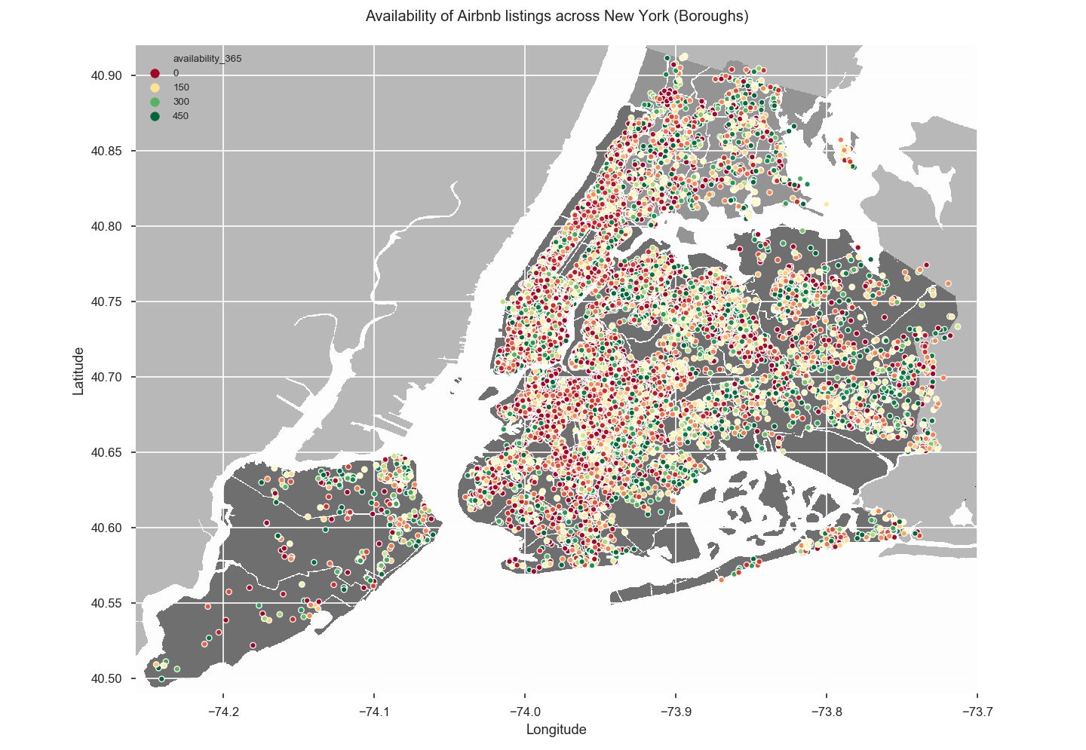

Slide 29
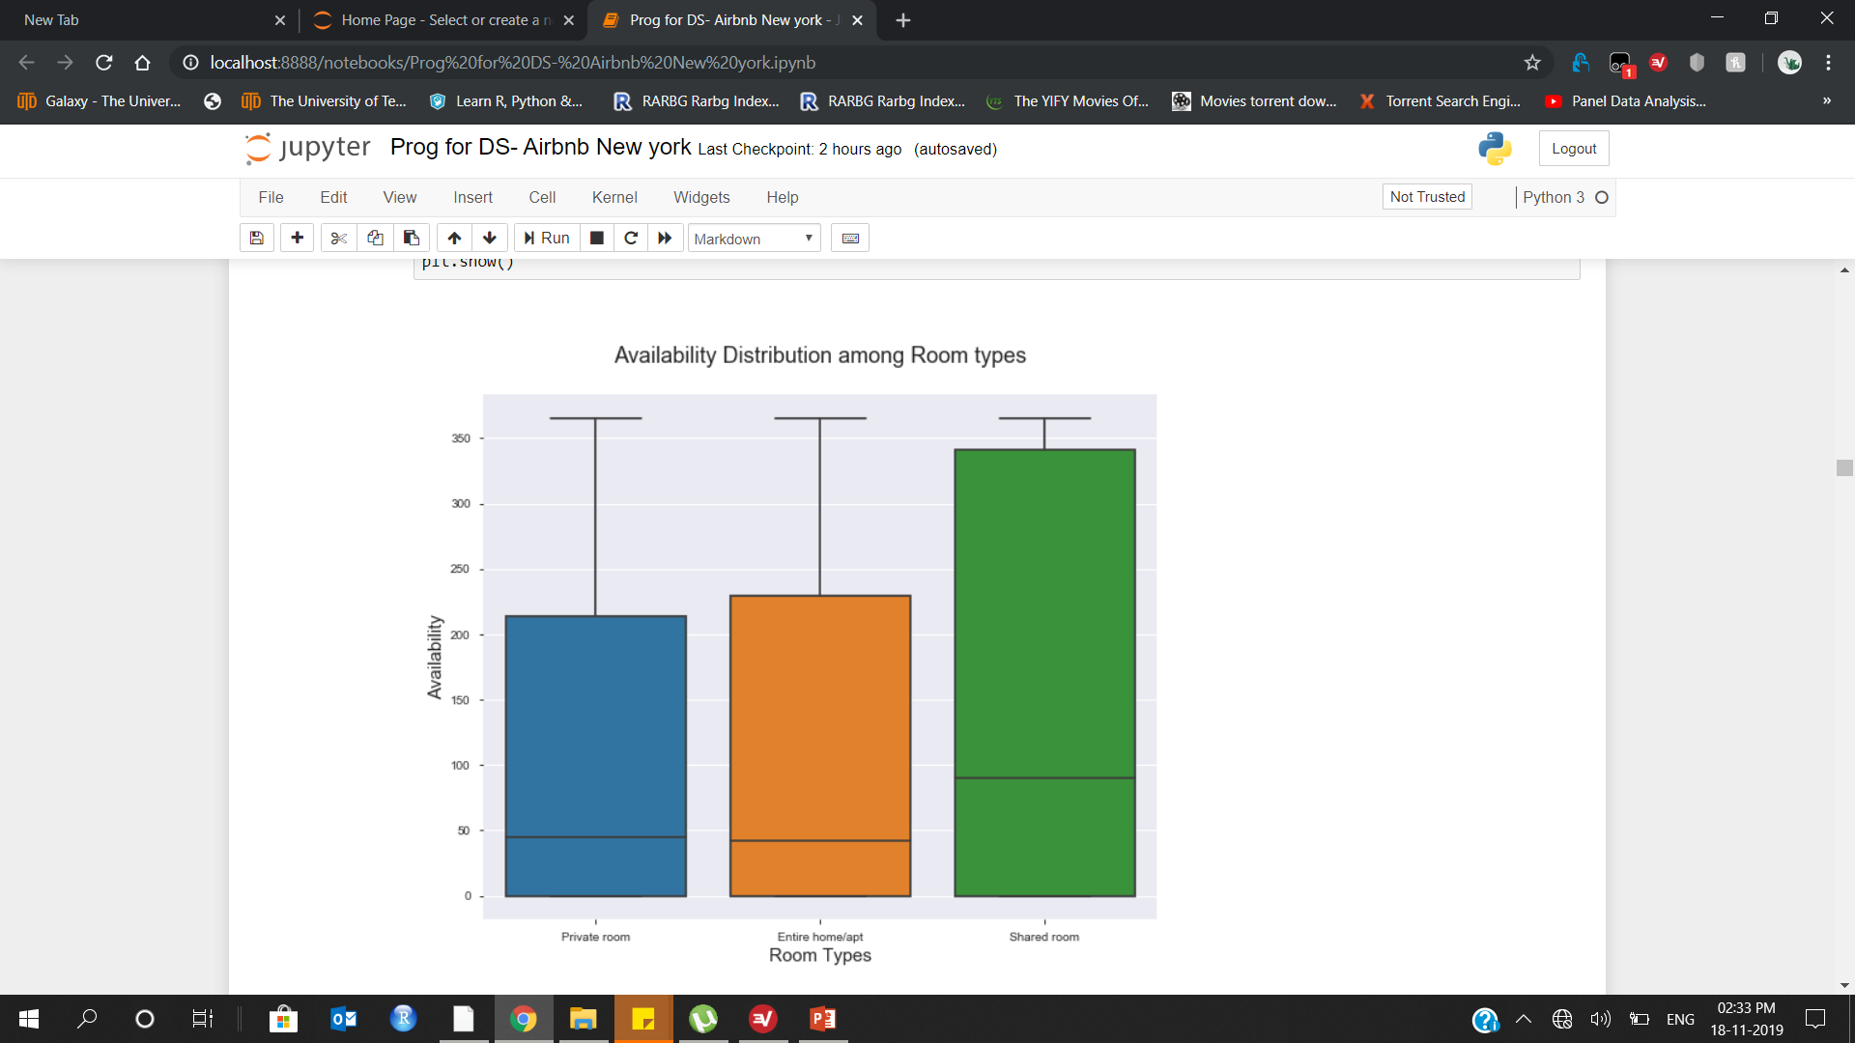
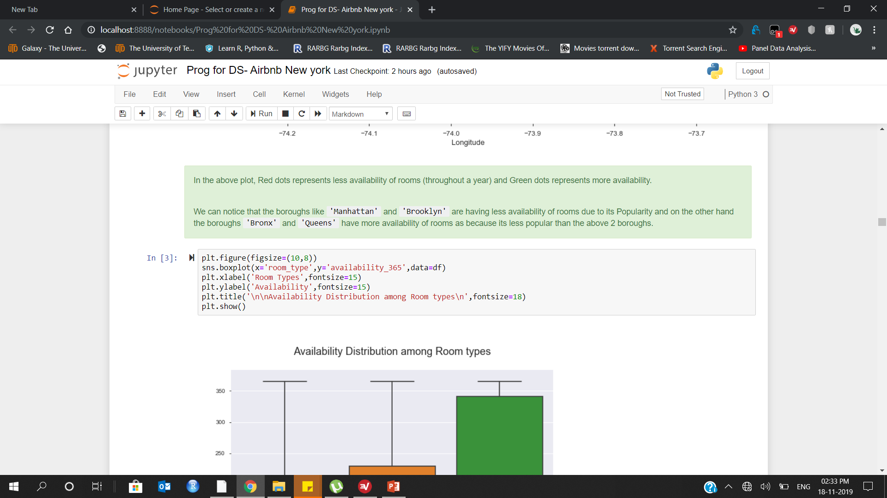
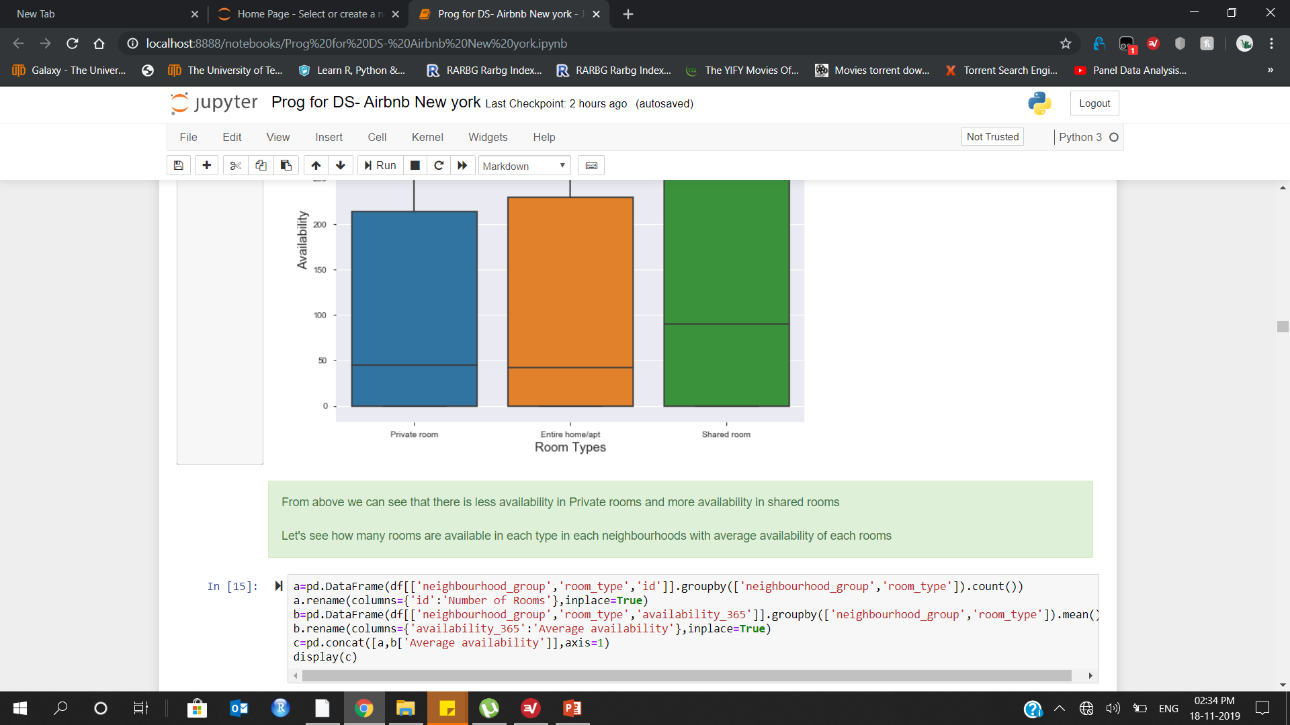
Let's explore the availability of the same rooms based on `room_type`

Slide 30
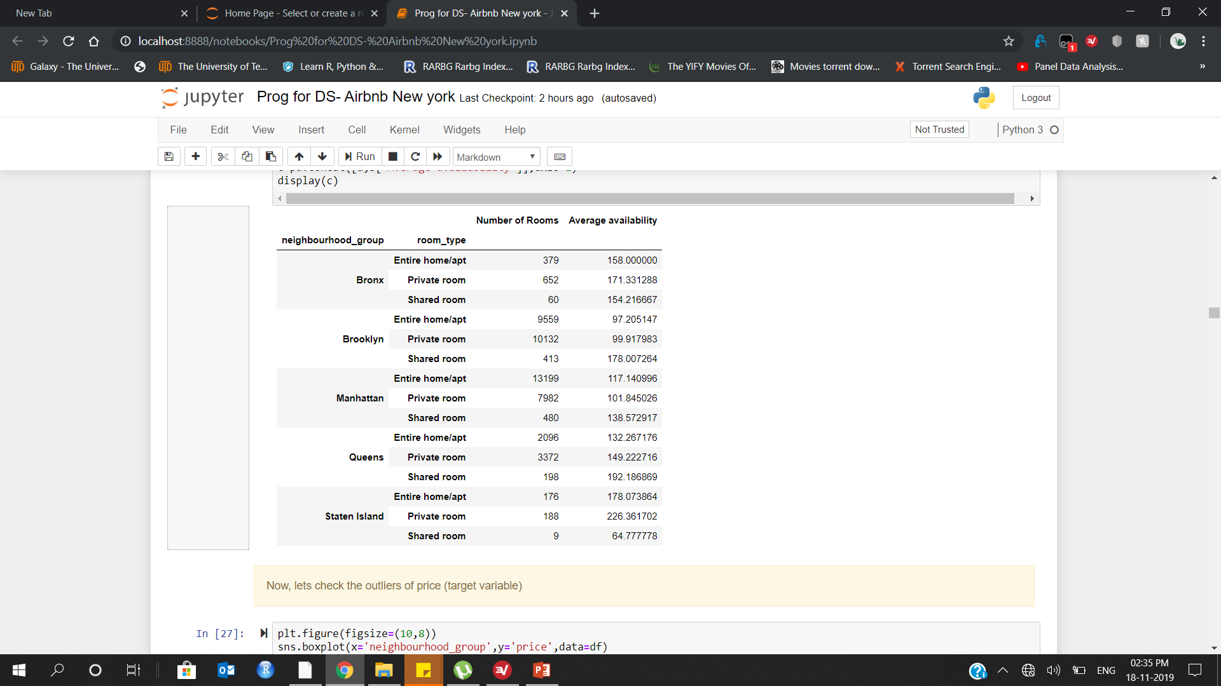
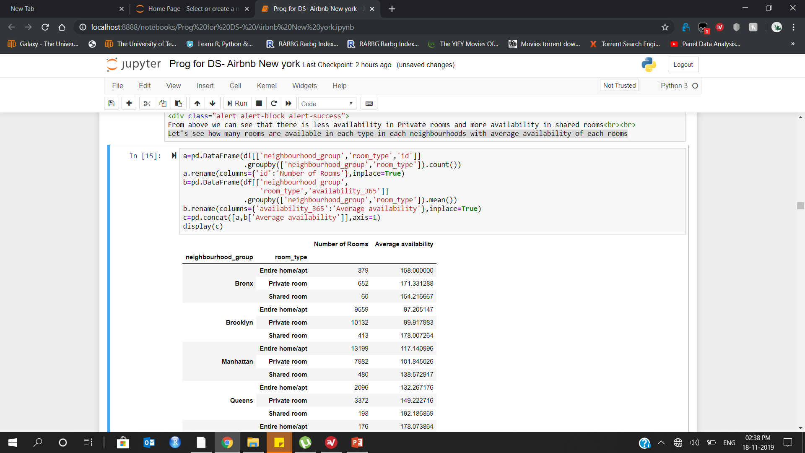
Let’s explore how many rooms are available in each type of rooms in each neighbourhoods & average availability of each rooms

Slide 31
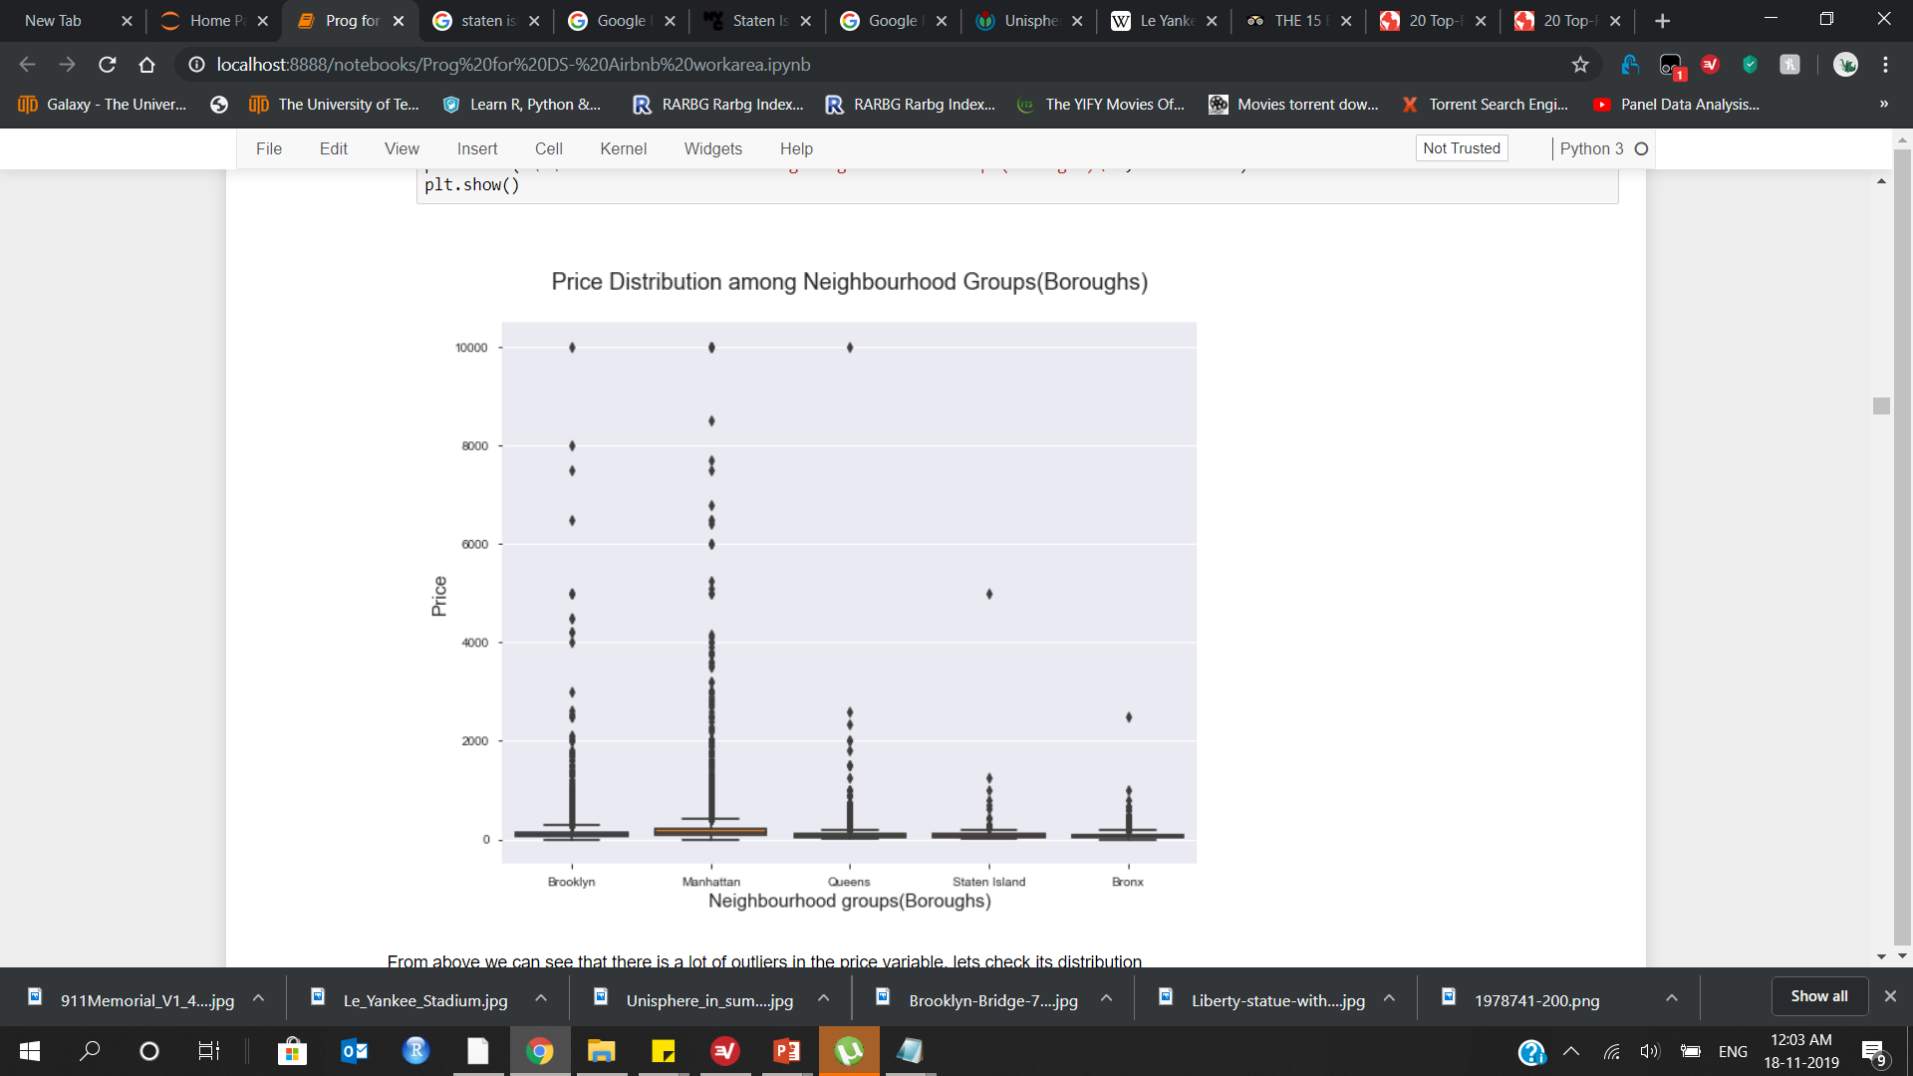
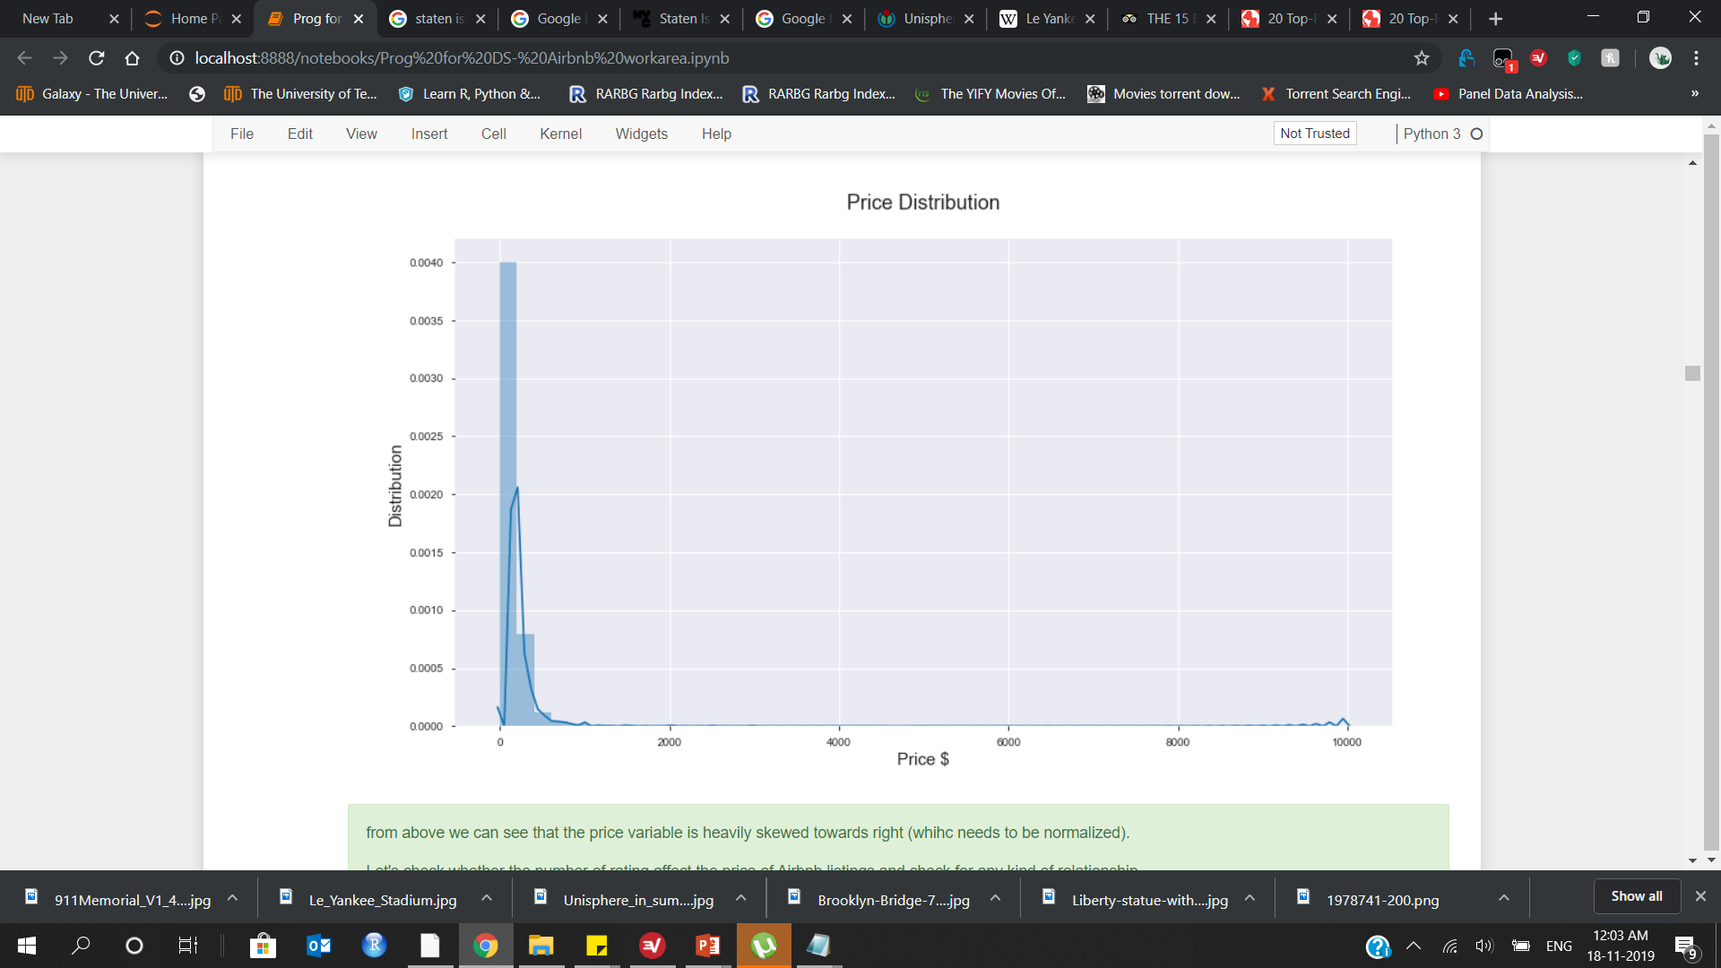
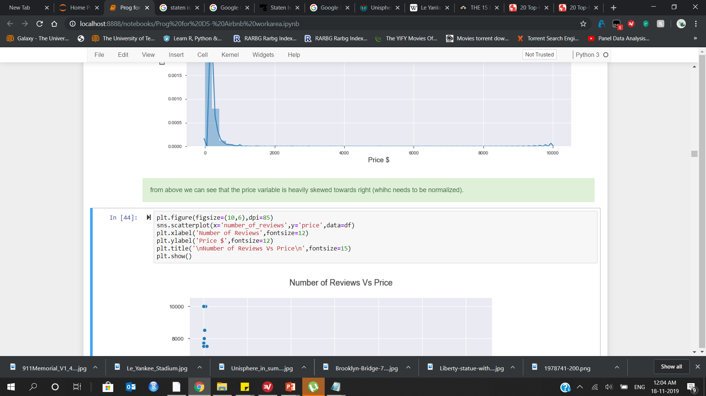
Distribution of price among various neighbourhood_group to check for outliers(Box-plot) and skewness(Histogram)

Slide 32
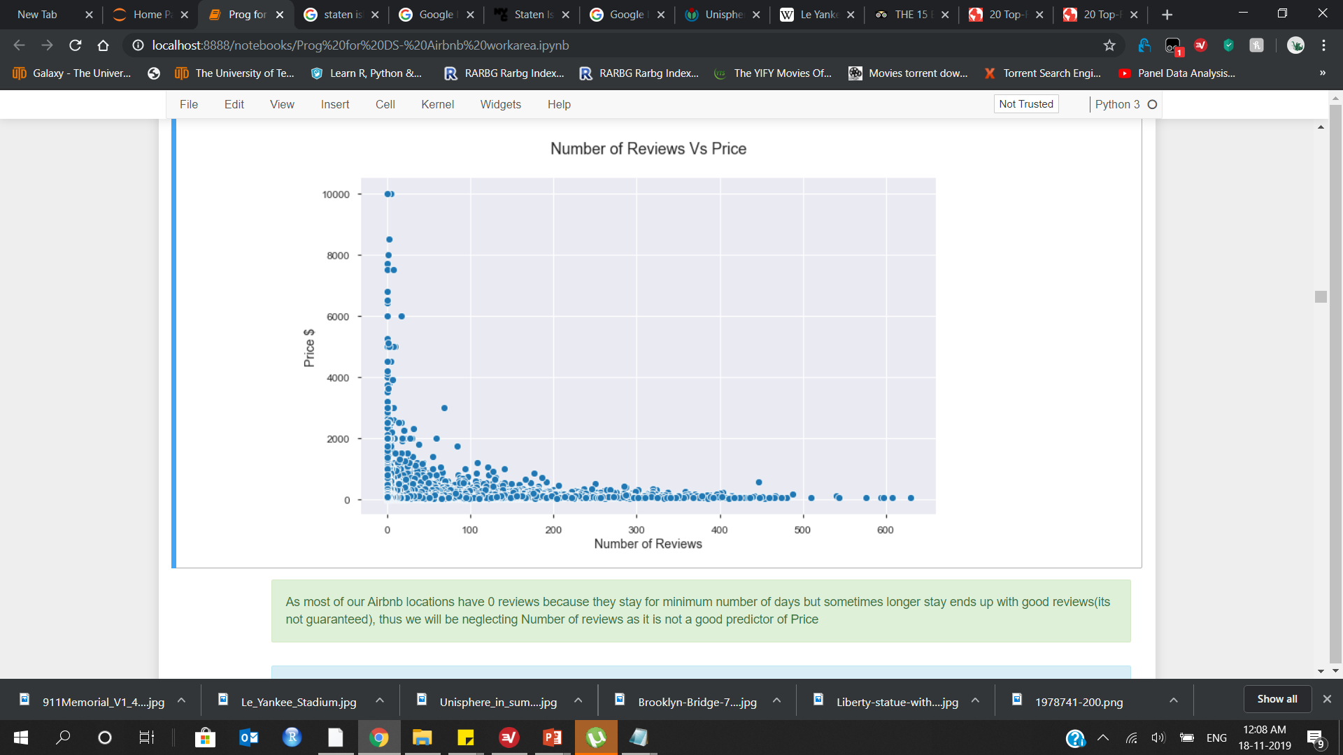
Let’s check whether, there is any relationship between number_of_reviews and price variable

Slide 33
DATA WRANGLING :
1. Identify and handling missing values
2. Data Formatting (categorical to numerical, changing datatypes)
3. Categorical data transformation (One-Hot Encoding)
4. Duplicates Removal
5. Skewness
6. Outliers

Slide 34
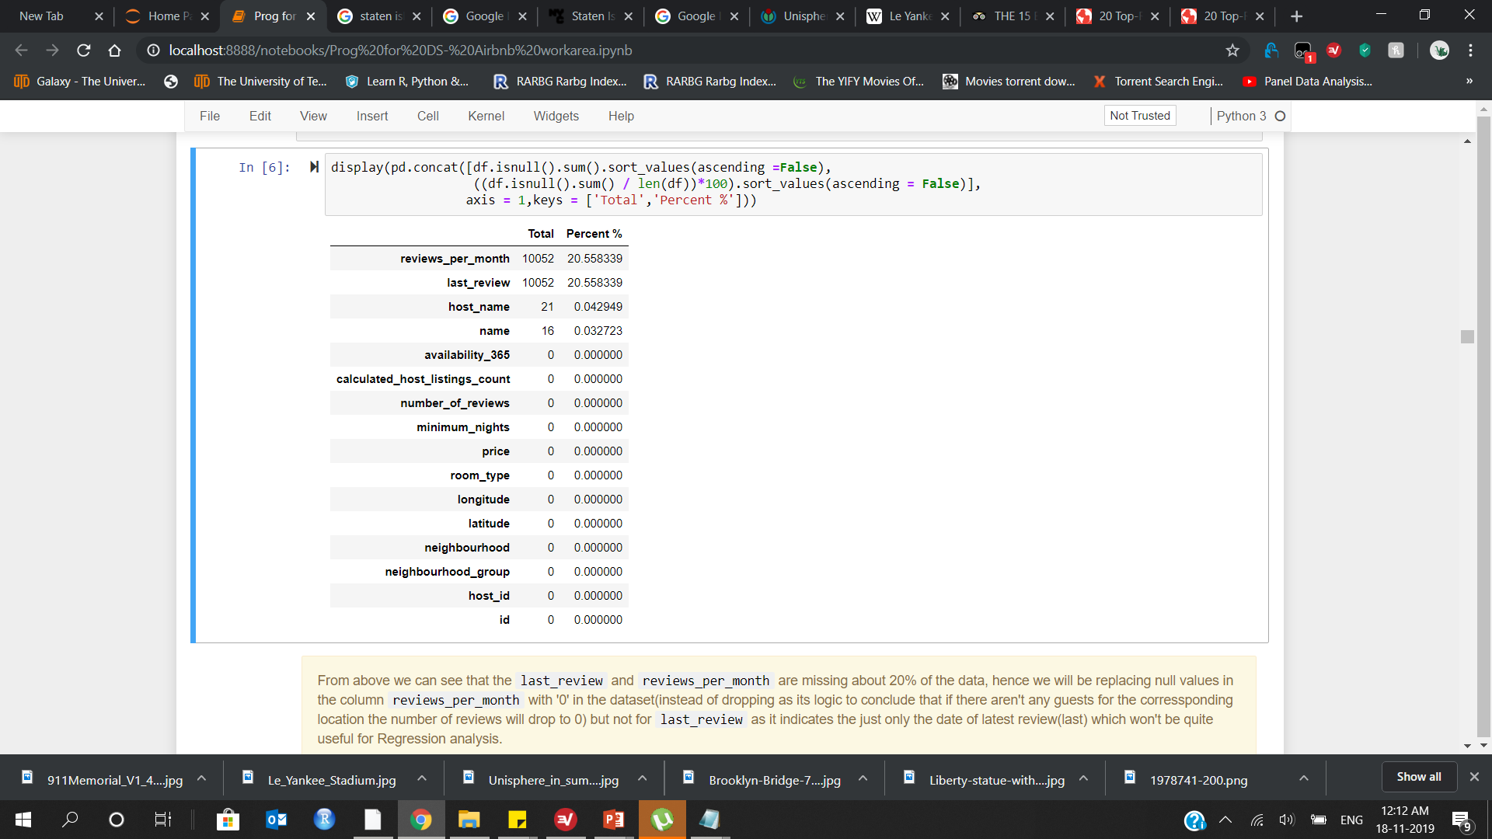
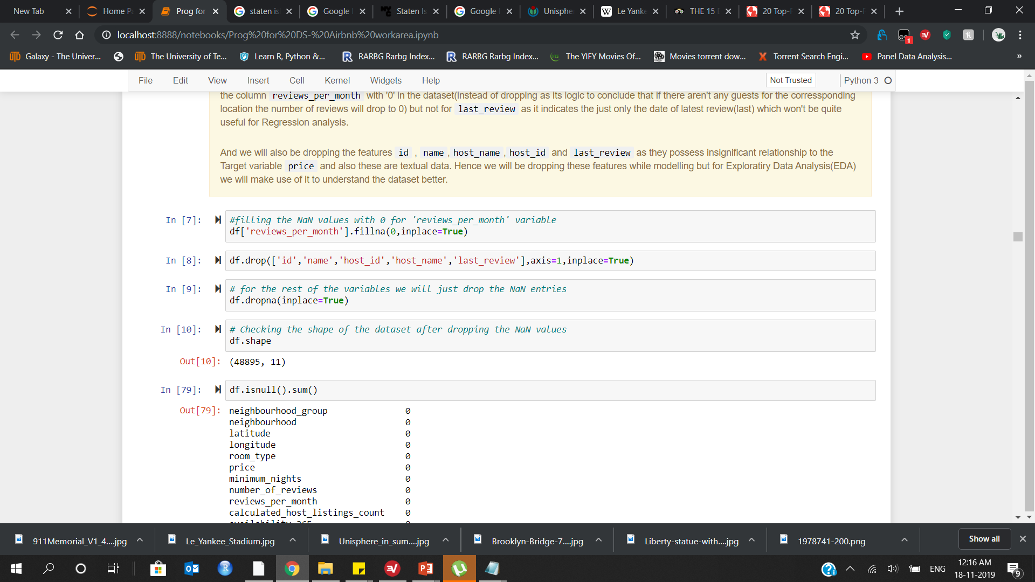
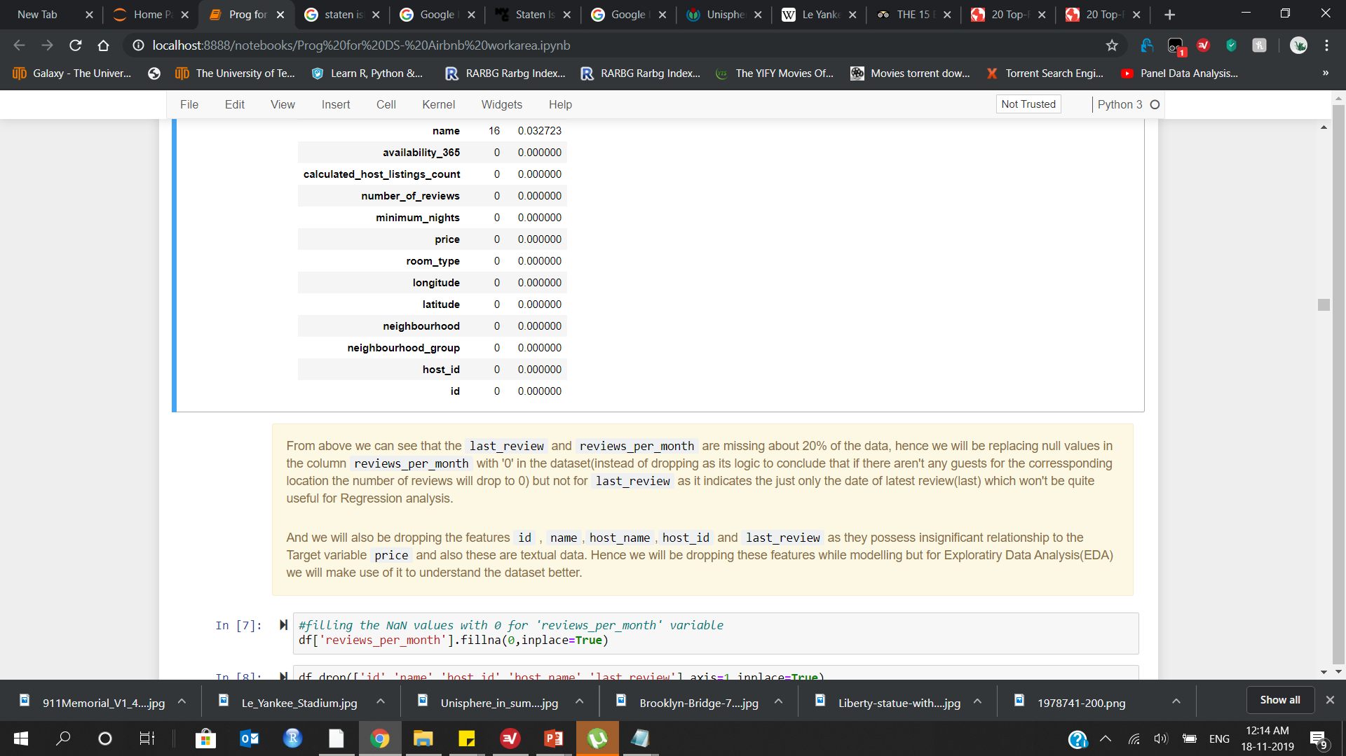
MISSING VALUES :

Slide 35
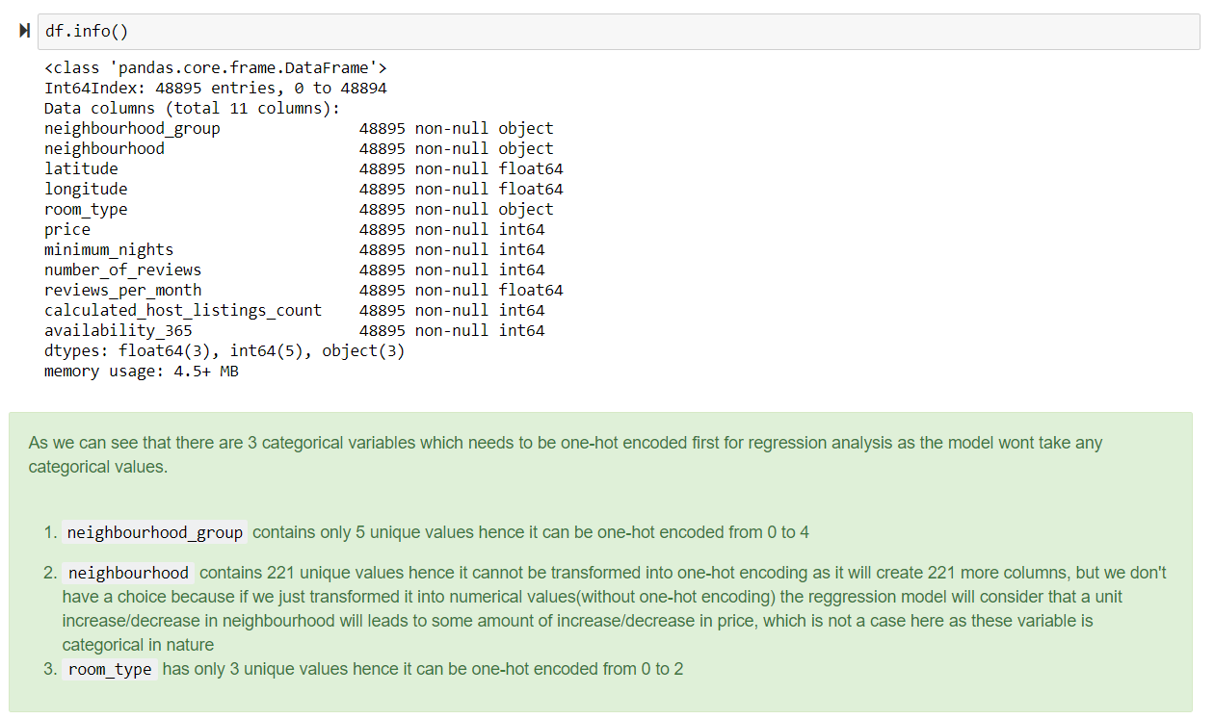
CATEGORICAL DATA TRANSORMATION:

Slide 36
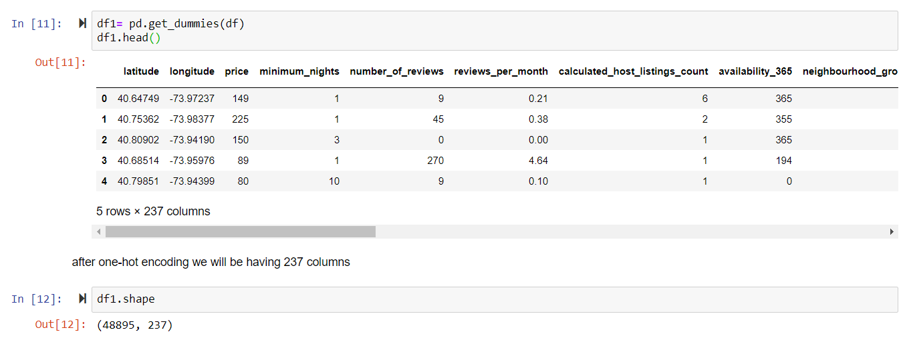
ONE-HOT ENCODING:

Slide 37


SKEWNESS:
If a independent/dependent variable has a right skew (mean > median). Taking the log would make the distribution of your transformed variable appear more symmetric (more normal). However, this is not a very good reason to log your variable. There are no regression assumptions that require your independent or dependent variables to be normal. However, if you have outliers in your dependent or independent variables, a log transformation could reduce the influence of those observations.
The variance of your regression residuals are increasing with your regression predictions. Taking the log of your dependent and/or independent variables may eliminate the heteroscedasticity of residuals and thereby improves the fitness of the model.

Slide 38


Before Log Transformation
After Log Transformation
price
minimum_nights
Calculated_host_listings_count
reviews_per_month
availability_365

Slide 39

DATA PARTITIONING :
We will split/partition the data in to train and test split with 70% and 30% respectively
Here we will be using RobustScaler to scale the data to nullify the effect of outliers present in the dataset

Slide 40





Knn regressor
Svr – rbf kernel
Based on the closest nearest neighbor distance(Manhattan or Euclidean) it will classify or assign the datapoints.
Support Vector Regressor with the Radial Bias Function Kernel.
linear regression
Decision trees
To capture the linear relationship between the dependent and independent variable.
Based on gini index a split will be made at each node to completely classify the data.
DATA MODELLING
Random forest
ridge regression
Utilizes bagging (bootstrapping and aggregating) strategy with base estimator as decision tree and creates a n number of trees based on which the model predicts. Here all the trees are independent to each other.
Regularized Linear model which penalizes the higher coefficients by using alpha parameter to eliminate the overfitting issues.
gradient Boosting
Lasso regression
Stochastic Gradient Boosting Regressor in which all the weak learners will be combined to forma a strong learner. Here decision tree is the base estimator and all estimators are dependent on each other(learns by residuals of the previous decision tree)
Least Absolute Shrinkage Selective Operator which penalizes the higher coefficients by using the parameter alpha to eliminate the overfitting issues and helps with feature selection
Notes:
© Copyright Showeet.com

Slide 41



Linear svr
Linear Support Vector Regressor for the regression tasks.
It implements an original proprietary version of a cutting plane algorithm for designing a linear support vector machine
Artificial neural network
Artificial Neural networks (ANN) are computational algorithms. It intended to simulate the behavior of biological systems composed of “neurons” and inspired by an central nervous systems. It is capable of machine learning as well as pattern recognition
Data modelling
Polynomial regression
polynomial regression is a form of regression analysis in which the relationship between the independent variable x and the dependent variable y is modelled as an nth degree polynomial in x. it fits a nonlinear relationship between x and y, denoted E(y |x)
K means clustering
k-means clustering aims to partition n observations into k clusters in which each observation belongs to the cluster with the nearest mean, serving as a prototype of the cluster.
Notes:
© Copyright Showeet.com

Slide 42



KNN REGRESSOR
Grid search parameters:
knnparameters = {'n_neighbors':range(15,25)}
Grid Search Results(embedded):

Slide 43


Results:
The best fitted line by the KNN Model
Best Parameters ={ 'n_neighbors’: 16}
Metrics:
Best Score(accuracy) : 0.5409
Test Score (accuracy) : 0.5626
Mean Squared Error : 0.4546
R2 Score : 0.5626
Mean Absolute Error : 0.3285

Slide 44


LINEAR REGRESSION
Metrics:
Train Score (accuracy) : 0.5540
Test Score (accuracy) : -3.2041
Mean Squared Error : 123059676.092
R2 Score : -3.2041
Mean Absolute Error : 1801289.535

Slide 45



RIDGE REGRESSION
Best Parameters: { ‘alpha’: 10 }
Metrics:
Train Score (accuracy) : 0.5474
Test Score (accuracy) : 0.5626
Mean Squared Error : 0.2067
R2 Score : 0.5626
Mean Absolute Error : 0.3289
The best fitted line by the Ridge Model

Slide 46



LASSO REGRESSION
Best Parameters: { ‘alpha’: 1e-05 }
Metrics:
Train Score (accuracy) : 0.5470
Test Score (accuracy) : 0.5622
Mean Squared Error : 0.2069
R2 Score : 0.5622
Mean Absolute Error : 0.3292
The best fitted line by the LASSO Model

Slide 47


POLYNOMIAL REGRESSION
For Degree = 2
Metrics:
Train Score (accuracy) : 0.6296
Test Score (accuracy) : -494221579336.88
Mean Squared Error : 233582513324.7001
Root Mean Squared Error : 483303.748
R2 Score : -494221579336.88
Mean Absolute Error : 21123.2228

Slide 48



LINEAR SUPPORT VECTOR
REGRESSOR
Best Parameters: { ‘C’: 0.1 }
Metrics:
Train Score (accuracy) : 0.5381
Test Score (accuracy) : 0.5534
Mean Squared Error : 0.2110
R2 Score : 0.5534
Mean Absolute Error : 0.3243
The best fitted line by the Linear SVR Model

Slide 49



SUPPORT VECTOR REGRESSOR
RADIAL KERNEL
Best Parameters: { ‘C’: 1 , ‘gamma’:0.1 }
Metrics:
Train Score (accuracy) : 0.6105
Test Score (accuracy) : 0.5944
Root Mean Squared Error : 0.4377
R2 Score : 0.5944
Mean Absolute Error : 0.3068
The best fitted line by the SVR Radial Kernel Model

Slide 50



DECISION TREE REGRESSOR
Best Parameters: { ‘max_depth’ : 8}
Metrics:
Train Score (accuracy) : 0.5352
Test Score (accuracy) : 0.5432
Root Mean Squared Error : 0.4646
R2 Score : 0.5432
Mean Absolute Error : 0.3311
The best fitted line by the Decision Tree Model

Slide 51



RANDOM FOREST REGRESSOR
Best Parameters: { ‘max_depth’ : 15, ‘n_estimators’:100}
Metrics:
Train Score (accuracy) : 0.5890
Test Score (accuracy) : 0.6074
Root Mean Squared Error : 0.4307
R2 Score : 0.6074
Mean Absolute Error : 0.3076
The best fitted line by the Random Forest Model

Slide 52



STOCHASTIC GRADIENT BOOSTING
REGRESSOR
Best Parameters: { ‘learning_rate’ : 0.05 }
Metrics:
Train Score (accuracy) : 0.8242
Test Score (accuracy) : 0.6170
Root Mean Squared Error : 0.4254
R2 Score : 0.6170
Mean Absolute Error : 0.3037
The best fitted line by the Gradient Boosting Model

Slide 53



ARTIFICIAL NEURAL NETWORK
KERAS
Metrics:
Test Score (accuracy) : 0.5821
Root Mean Squared Error : 0.4443
R2 Score : 0.5821
Mean Absolute Error : 0.3252
The best fitted line by the ANN Model

Slide 54
SCORES COMPARISON
Models | Train Accuracy | Test Accuracy | Root Mean Squared Error | R2 Score | Mean Absolute Error
KNN Regressor | 0.5409 | 0.5626 | 0.6742 | 0.5626 | 0.3285
Linear Regression | 0.554 | -3.2041 | 11093.2266 | -3.2041 | 1801289.535
Ridge Regression | 0.5474 | 0.5626 | 0.4546 | 0.5626 | 0.3289
LASSO Regression | 0.547 | 0.5622 | 0.4549 | 0.5622 | 0.3292
Polynomial Regression | 0.6296 | -4.94222E+11 | 483303.7485 | -4.942E+11 | 21123.2228
Linear SVR | 0.5381 | 0.5534 | 0.4593 | 0.5534 | 0.3243
SVR Radial Kernel | 0.6105 | 0.5944 | 0.4377 | 0.5944 | 0.3068
Decision Tree | 0.5352 | 0.5432 | 0.4646 | 0.5432 | 0.3311
Random Forest Regressor | 0.589 | 0.6074 | 0.4307 | 0.6074 | 0.3076
Stochastic Gradient Boosting | 0.8242 | 0.6170 | 0.4254 | 0.6170 | 0.3037
Artifical Neural Network | 0.6032 | 0.5821 | 0.4443 | 0.5821 | 0.3252

Slide 55

RANKING OF MODELS
Gradient BOOSTING
Accuracy score : 0.6170
Root Mean Squared Error : 0.4254
1
2
Random forest
Artificial neural network
3
Accuracy score : 0.6074
Root Mean Squared Error : 0.4307
Accuracy score : 0.5821
Root Mean Squared Error : 0.4443
4
5
Ridge regression
Svm – raidal kernel
Accuracy score : 0.5626
Root Mean Squared Error : 0.4546
Accuracy score : 0.5944
Root Mean Squared Error : 0.4377
Notes:
© Copyright Showeet.com – Creative & Free PowerPoint Templates

Slide 56


K MEANS CLUSTERING
Optimal number of clusters: 5

Slide 57

In the plot we can see that the :
Cluster 1 is formed where we have availability less than 150 days and price ranges 0 to 400 dollars
Cluster 2 is having all the availability and price ranges between 5000 to 10000 dollars
Cluster 3 is having all the availability and price ranges 400 to 1400 dollars
Cluster 4 is having availability more than 150 days and price ranges 0 to 400 dollars
Cluster 5 is having all the availability and price ranges 1400 to 5000 dollars

Slide 58


 |  | 1 | 2 | 3 | 4 | 5
latitude | count | 30832 | 26 | 2771 | 15118 | 148
 | mean | 40.72902245 | 40.72987308 | 40.73615508 | 40.7274414 | 40.73252568
 | std | 0.053798454 | 0.044031122 | 0.03888035 | 0.05831602 | 0.047306644
 | min | 40.50943 | 40.63952 | 40.53076 | 40.49979 | 40.57645
 | 25% | 40.69067 | 40.699695 | 40.715795 | 40.6866325 | 40.71692
 | 50% | 40.721515 | 40.72195 | 40.73795 | 40.723285 | 40.736115
 | 75% | 40.7635425 | 40.768205 | 40.761125 | 40.76313 | 40.76051
 | max | 40.90734 | 40.82511 | 40.89338 | 40.91306 | 40.88671
longitude | count | 30832 | 26 | 2771 | 15118 | 148
 | mean | -73.95300702 | -73.97362808 | -73.97452523 | -73.94610103 | -73.97528196
 | std | 0.041392961 | 0.041383372 | 0.034175156 | 0.055045767 | 0.037202553
 | min | -74.24442 | -74.0973 | -74.20295 | -74.24285 | -74.02884
 | 25% | -73.98151 | -73.9951625 | -73.99467 | -73.98289 | -73.9983975
 | 50% | -73.95511 | -73.981075 | -73.98137 | -73.952315 | -73.98275
 | 75% | -73.93803 | -73.9538525 | -73.962275 | -73.92568 | -73.96408
 | max | -73.71795 | -73.88128 | -73.73874 | -73.71299 | -73.77069
price | count | 30832 | 26 | 2771 | 15118 | 148
 | mean | 115.9383108 | 7087.269231 | 515.6062793 | 128.8053314 | 2245.777027
 | std | 64.73356263 | 1916.54125 | 198.0064228 | 75.04495713 | 787.800916
 | min | 0 | 5000 | 295 | 0 | 1395
 | 25% | 65 | 5137.5 | 378.5 | 68 | 1599
 | 50% | 100 | 6500 | 450 | 110 | 2000
 | 75% | 150 | 8375 | 599 | 177 | 2606.5
 | max | 345 | 10000 | 1369 | 370 | 4500
(Half the table only pasted)

Slide 59
THANKS!

Slide 60
CREDITS
Presentation template by Pradeep Munikrishnan
Icons by Daniel Liao
Infographics by Gowtham
Author introduction slide photo created by Kashish
Text & Image slide photo created whole team

